Slide 1
What is a writer?

Slide 2
What is a writer?
What separates a writer from someone who writes shopping lists and the occasional stroppy email?

Slide 3
What is a writer?
Someone who has written (or plans to write) something, sometime, that they, or someone else, thought (or will think) was worth reading.

Slide 4
Last month
John Hoover told us:
If you want to do what you want, when you want, and get paid lots of money for doing it, don’t be a writer.
If you’re going to put all this time and effort into your writing, you’d better be writing something you’re passionate about.

Slide 5
Which speaks to:
YOUR PURPOSE – If you want to do what you want, when you want, and get paid lots of money for doing it, don’t be a writer.
And YOUR PASSION – If you’re going to put all this time and effort into your writing, you’d better be writing something you’re passionate about.

Slide 6
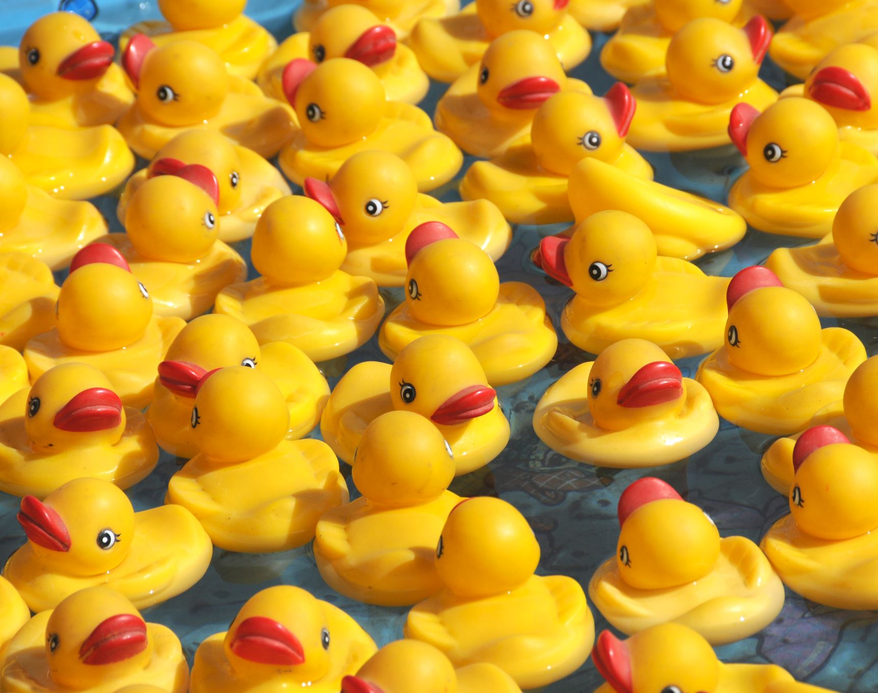
I’m going to talk about getting your (writing) ducks in a row… and pointing in the same direction.
Purpose
Passion
Plan
Plot
Practicalities
Priorities
Procrastination
And maybe even… Productive Procrastination

Slide 7

Starting with purpose… Why do you write?

Slide 8

What’s your Purpose?
Have fun
Stop your son from pestering you
Keep a record of your family history
Feel like you’ve got something to say
Get those voices our of your head
Achieve something worthwhile
…

Slide 9

What’s your Passion?

Slide 10
What’s your Passion?
History
Family
Middle-grade kids
Memories
Politics
Humor
…

Slide 11

What’s the difference between Passion and Purpose?

Slide 12
Purpose tells your what you want to do.
Passion drives you to do it.

Slide 13
So how do you make passion and purpose point in the same direction?
If your purpose is to please your grandchild, and your passion is for family history, what happens when your grandchild says “Boring”?
If your purpose is to earn a fortune, and your passion is for niche topics…?
If your purpose is…?

Slide 14
So how do you make passion and purpose point in the same direction?
If your purpose is to please your grandchild, and your passion is for family history, what happens when your grandchild says “Boring”?
Change your purpose to keeping the history alive…
If your purpose is to earn a fortune, and your passion is for niche topics…?
Change your purpose to writing something of value…
If your purpose is…?

Slide 15
So, you have PURPOSE: you know what you’re doing. You have PASSION: you know why you’re doing it…
Must be time to ask How will you do it.

Slide 16


Do you have a plan?

Slide 17
Do you have a plan?
Nanowrimo – plan to write 1,200 words a day?
Determined to finish – plan to spend 2 hours a day?
Permanently procrastinating – plan to plan?
Plan to write as a treat at the end of a busy day
What about you?

Slide 18

Does your plan include a plot?
Not just a plot for what you’re writing, but also a plot for you:
when, how, where, over what period of time, in what sort of places you might write.

Slide 19

What’s the difference between plan and plot?
Probably lots of differences, but for our purposes, let’s say:
PLAN is your overall guide
PLOT is your next step

Slide 20
Does your plan include a (personal) plot?
Plotting the story?
Research?
Reading more?
Setting aside some writing time? Or
Switch on the computer and see where you end up?

Slide 21
Does your plan include a (writing) plot?
Map out your writing from beginning to end?
Look for the waypoints then reach them one by one?
Keep your eye on the goal and see where the story takes you? Or again…
Switch on the computer and see where you end up?

Slide 22
How do you make your plan and passion point in the same direction?
If your passion is for history, and you’re planning a futuristic epic?
If your passion is for adults and you’re planning a childrens’ picture book?
If your plan…?

Slide 23
How do you make your plan and passion point in the same direction?
If your passion is for history, and you’re planning a futuristic epic?
Maybe you’re combining passions
If your passion is for adults and you’re planning a childrens’ picture book?
Maybe you’re trying to help adults understand children (or vice versa)
If your plan…?

Slide 24
How do you make plan and plot point in the same direction?
If your plan is to write 2,000 words a day and your plot says you need to research something first?
If your plan is to finish by Christmas and your plot says you can’t start until Thanksgiving?
If your plan…?

Slide 25
How do you make plan and plot point in the same direction?
If your plan is to write 2,000 words a day and your plot says you need to research something first?
Change your plan to include research
If your plan is to finish by Christmas and your plot says you can’t start until Thanksgiving?
Change your plot to start earlier
If your plan…?

Slide 26
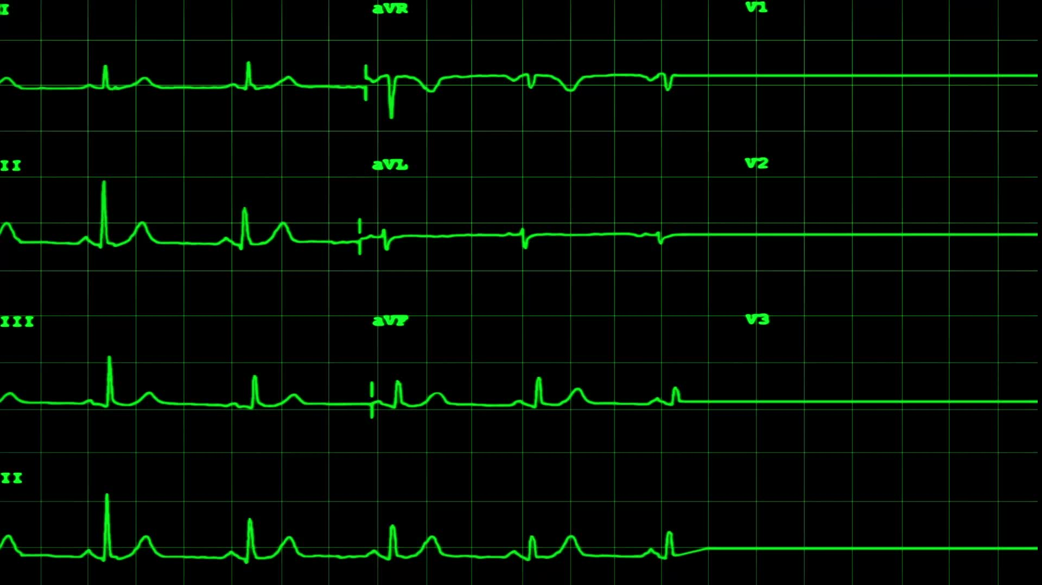
PURPOSE
PASSION
PLAN
PLOT
If you get them all “in line” all pointing the same way…

Slide 27

Now What?

Slide 28

How does it all fit in with the practicalities of your life?
Do you have time to write?
Do you have space where you can write?
Have you run out of ideas?
Do you have too many ideas?
…

Slide 29
How does all this fit in with the practicalities of your life?
Do you have time to write?
Do you have space where you can write?
Have you run out of ideas?
Do you have too many ideas?
Can writing even fit in with your current priorities (because writing isn’t the only thing in your life)?

Slide 30
How do those practicalities relate to your priorities?
What’s going on in your world?
What matters more to you than writing. (HINT: something should.)
And are you still a writer if you procrastinate?

Slide 31
So… Try to get your ducks in a row
Let your passion drive your purpose
Plan to achieve that purpose
Plot a next step that fits with your plan, or
If your priorities and practicalities are getting in the way, try some…

Slide 32
Productive Procrastination
Not the same as “Oh, I’ll just do it tomorrow.”
PRODUCTIVE procrastination prepares you to do it, “when…”

Slide 33
Productive Procrastination
Use this time to let new ideas, new dreams, new hopes, new experiences soak into your passion and purpose. Let your writing mature.

Slide 34

So, if you’re struggling to write, PROCRASTINATE PRODUCTIVELY, and know…
You were a writer
You’re still a writer
You will be a writer
And you belong right here in our community of writers!

Slide 35
You belong here
because we’ll encourage you to get those ducks in a row, while you’re waiting to write!

Slide 36
And if you’re not productively procrastinating…

Slide 37
STOP procrastinating,
get those ducks in a row, and
START productively writing instead.

Slide 38
Any Questions?

Slide 39
We’re going to introduce ourselves to each other, but first…
We’re going to introduce ourselves (as writers) to ourselves, and here’s how:

Slide 40
We’re going to introduce ourselves to each other, but first…
We’re going to introduce ourselves to ourselves, and here’s how:
My name is … and I am a writer.

Slide 41
We’re going to introduce ourselves to each other, but first…
We’re going to introduce ourselves to ourselves, and here’s how:
My name is … and I am a writer.
One of the reasons / The main reason / The only reason I write is …

Slide 42
We’re going to introduce ourselves to each other, but first…
We’re going to introduce ourselves to ourselves, and here’s how:
My name is … and I am a writer.
One of the reasons / The main reason / The only reason I write is …
One of the things I plan to write this year is …

Slide 43
We’re going to introduce ourselves to each other, but first…
We’re going to introduce ourselves to ourselves, and here’s how:
My name is … and I am a writer.
One of the reasons / The main reason / The only reason I write is …
One of the things I plan to write this year is …
One of the people / One group of people I hope will read this is …

Slide 44
We’re going to introduce ourselves to each other, but first…
We’re going to introduce ourselves to ourselves, and here’s how:
My name is … and I am a writer.
One of the reasons / The main reason / The only reason I write is …
One of the things I plan to write this year is …
One of the people / One group of people I hope will read this is …
One of the places they might find it is …

Slide 45
We’re going to introduce ourselves to each other, but first…
We’re going to introduce ourselves to ourselves, and here’s how:
My name is … and I am a writer.
One of the reasons / The main reason / The only reason I write is …
One of the things I plan to write this year is …
One of the people / One group of people I hope will read this is …
One of the places they might find it is …
One of the ways I will encourage them to read it is …

Slide 46
We’re going to introduce ourselves to each other, but first…
We’re going to introduce ourselves to ourselves, and here’s how:
My name is … and I am a writer.
One of the reasons / The main reason / The only reason I write is …
One of the things I plan to write this year is …
One of the people / One group of people I hope will read this is …
One of the places they might find it is …
One of the ways I will encourage them to read it is …
One of the ways the Writers’ Mill can help me with this is …

Slide 47

Our name is the Writers’ Mill and we are writers.
One of the reasons we write is we enjoy it.
One of the things we plan to write this year is our 2022 anthology.
One group of people we hope will read this is local readers.
One of the places they might find it is at Cedar Mill library.
One of the ways we will encourage them to read it is by asking the library to allow us to put up a poster.
One of the ways all of you can help us with this is by volunteering.

Slide 48
My name is … and I am a writer.
One of the reasons / The main reason / The only reason I write is …
One of the things I plan to write this year is …
One of the people / One group of people I hope will read this is …
One of the places they might find it is …
One of the ways I will encourage them to read it is …
One of the ways the Writers’ Mill can help me with this is …

