Slide 1

GROW YOUR OWN BOOK!
And publish it.

Slide 2





First Steps
Prepare the soil:
Create your kdp account.
1
Prepare your seeds:
Write and format your book. Probably you’ll write several different books and choose the one you want to use.
2
Make labels:
Decide what your cover will look like.
3
Transplant your seedling:
Upload the book to kdp.
4
Water it:
Set up sales channels, author pages, etc.
5
And watch it grow

Slide 3
Step 1
Prepare your kdp account

Slide 4
How to create your kdp account
What will you need?
An Amazon account. Go to amazon.com (or amazon.co.uk) and create one if you don’t already have one.
Click on “create your amazon account.”
Give them your email address
And set up your password
You don’t need to give them your credit card unless you’re buying something.
You can always remove your credit card after purchases, to stop them storing it (Go to account>payments).

Slide 5
How to create your kdp account
What else will you need?
Collect these things together before you start:
Your country – what country will you be paid in?
Your tax information – they have to tell the taxman when they pay you.
Your bank information – they need to know where to send the money. (If you’re in the UK, they’ll need international - IBAN and BIC/SWIFT – codes for your bank.)
They can’t pay by Paypal. They can pay by check, but only after you’ve earned enough, so you might be waiting forever.
They can only pay INTO the account, but you might want to use a separate account just for online stuff, to be extra safe.

Slide 6
Step 2
Prepare your book

Slide 7
How to prepare your (self-published) book
Two main methods:
DIY, which is what we will do – create our own pdf and epub files
Or KindleCreate, which lets you create the print (pdf) file and ebook (kpf) file with free Amazon software.
Download KindleCreate (google it; it’s FREE). Then install it.
Choose which things you want to have in the contents.
Make some fun choices about how to start chapters, format headings, etc.
And save.
Open KindleCreate and start a new project using your doc or docx file.

Slide 8
Why to use, or not use, KindleCreate
KindleCreate produces a really nice ebook file from your doc or docx. PLUS, you can edit inside kindle create and fix some of those errors you didn’t notice before, so it’s a good addition to your editing tools.
KindleCreate makes a “good enough” pdf file too, but doesn’t give you much control over widows and orphans – pages that have only two lines on them; pages that start with one word at the end of a paragraph, etc.
But KindleCreate is FREE and easy to use. You choose.
KindleCreate can’t cope with complicated tables and lists in an ebook, so you might need to use something else (Calibre for example) if you’re creating a book of sports analyses.

Slide 9
How to prepare your print book for yourself, just with Word
First, download some (Word) book templates

Slide 10
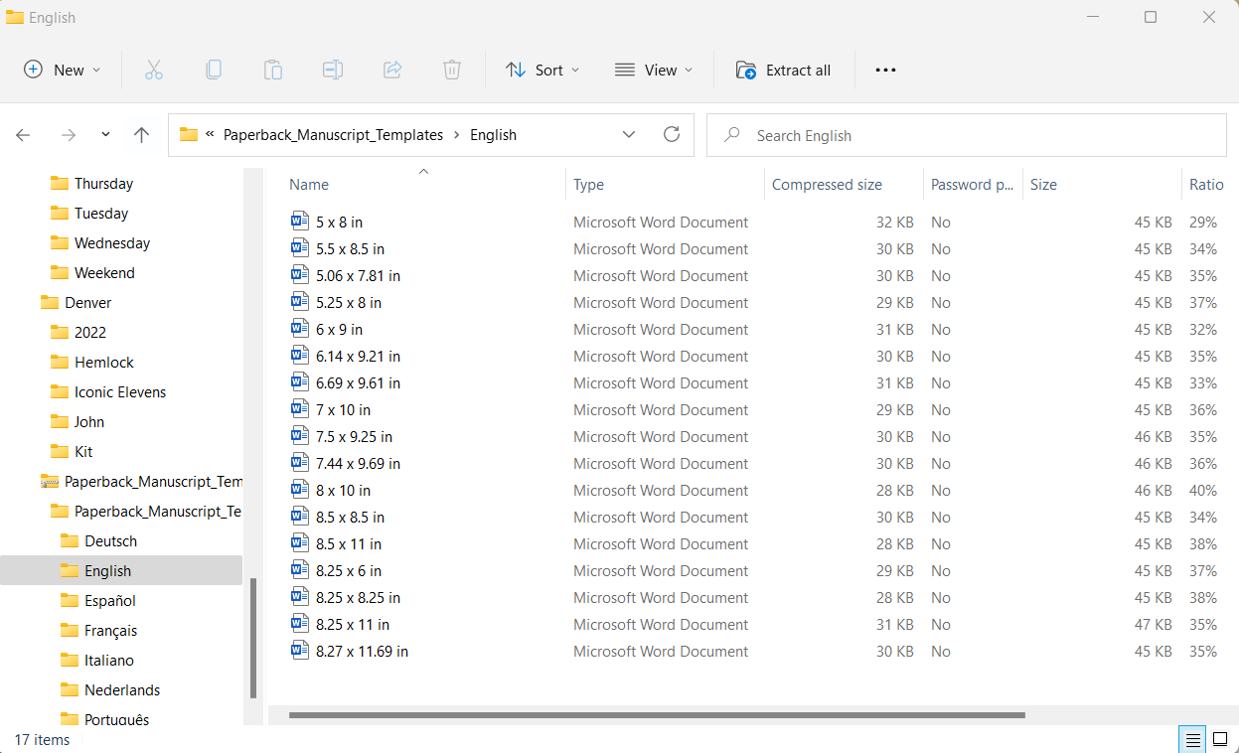
Google “kdp book templates”
Click on “download templates with sample content”
Save the “zip” file somewhere useful
“Extract” the file and store its contents somewhere useful
Open the “English” directory and choose your book size from the options available
Open the template file.

Slide 11
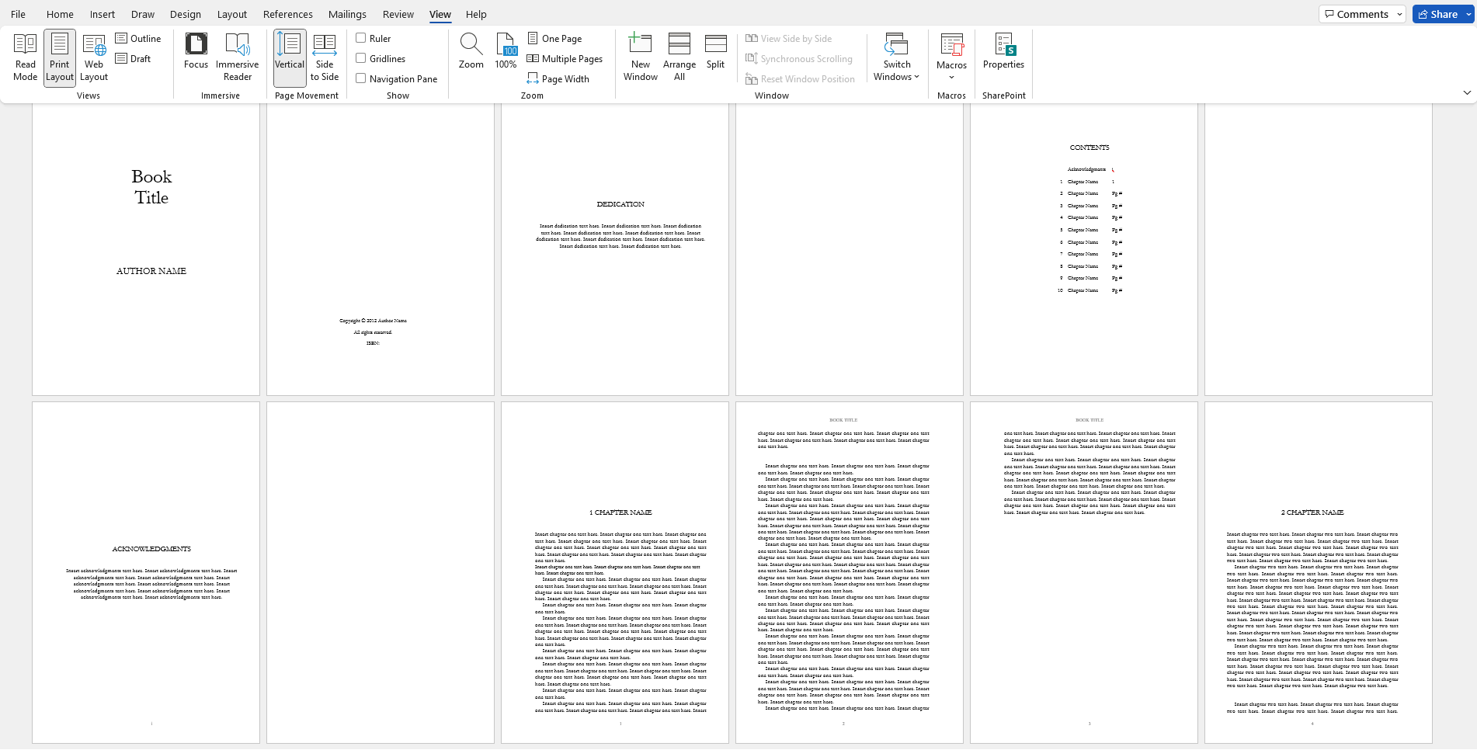

Slide 12
What does the Template give you?
The right page size, so you can see how your book will look.
Margins (and gutters) preset for you.
Fonts – yes, you can choose your own, but take a look at theirs first.
A good idea of what goes where – ISBN, dedication page, contents list, acknowledgments, etc.
A good idea of where to start each chapter (e.g. halfway down a page).
Headers and footers – page numbers etc.
And no, it doesn’t tell you everything, but it’s a great place to start.

Slide 13
Edit the template to create your book
Story book (or novel) with chapters – easy; just cut and paste your text into the relevant places in the template.
Poetry book with images – remember you can use images as background in Word – you can do lots of clever stuff with Word, but remember, images do tend to more around unpredictably.
Picture book – Replace the text with your image, then, maybe, add your text in a text box over the image.
If you’re going to have a contents page, make sure you update it!

Slide 14
Then SAVE your book
For a paperback or hardcover book, you will (ideally) want a pdf file.
Word lets you “save as pdf.”
Look at the pdf and see if it looks good. Try to avoid pages with only two lines of text, or lines of text with only one word.
Look on our website https://www.portlandwritersmill.org/help-2/lay-out-your-book-with-word/ for info on how to do a more professional job. Or use a more professional program.
For an ebook, you will want an epub or kpf file.
Word won’t let you save as epub (yet).
Again, look at the resulting file (e.g. with FREE kindle previewer) to make sure it looks good.
Or use Calibre, a FREE program which creates epub files from your Word doc or docx.
You can still use KindleCreate to create a kpf file from your Word doc.

Slide 15
Step 3
Cover your book

Slide 16
How do you make a book cover?
Amazon has a FREE “cover creator” which will help you create a simple, good-looking cover. Use it while uploading the book.
You can use stock images offered by Amazon. (There’s quite a variety, but someone else may use the same image and have an almost identical cover.)
You can use stock designs offered by Amazon (but be aware that if it’s not “simple,” it will be very obvious which other books used the same design).
You can use your own images. (Often a good idea.)
You can add the title to the image first, or just let Amazon tell you where to put it.
Or you can create your own pdf cover – it’s just a little more complicated and needs more (expensive) software.

Slide 17
What to put on your cover
Title (and subtitle)
Author
Image
Design

Slide 18
Pick your title (and subtitle) first
See https://www.portlandwritersmill.org/help-2/how-to-research-your-title/ for details
Search for the title on Google – what does it bring up?
1
Search for the title on Amazon – what does it bring up?
2
Make sure your title will attract the readers you want to sell to.
3
Make sure readers looking for similar books have a chance of finding yours.
4

Slide 19

Title and Author
Make sure the title is written correctly inside the book
1
Make sure the author name is written correctly inside the book
2
Amazon will reject your upload if the title and author names don’t agree:
3
E.g. if the author is “Fred Bloggs” on the cover but “Frederick Bloggs” inside.

Slide 20
Cover Image
Amazon has lots of free images.
Pixabay, Unsplash, Wikimedia etc also have free images (but be sure to check what you’re allowed to do with them).
Or you can use your own image.
Try to find something that fits the theme of your book.

Slide 21
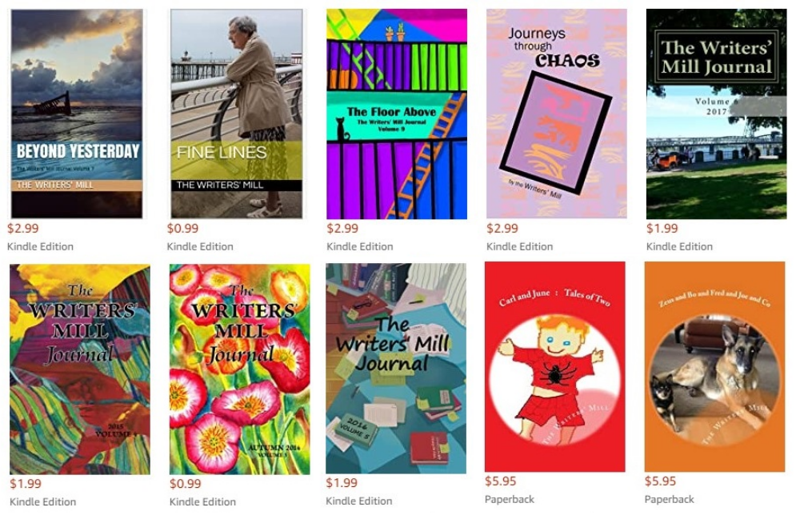
Cover Design
Journeys through Chaos was uploaded as a complete cover pdf file.
The Floor Above was uploaded as a 6x9 image with the title and subtitle text already added.
Beyond Yesterday was a photo that we copied onto the back cover as well.
Fine Lines was a single photograph, just on the front.

Slide 22
What do you need for your Cover?
For the ebook:
You will need a 6x9 inch image (for a 6x9” book), 300dpi (ideally), that will appear on Amazon next to the book title (or use Amazon’s cover creator with one of Amazon’s images). Amazon can help you add the title to your image.
For the print book:
You will need the same 6x9 image
Or you need a complete pdf file that includes front, back, and spine (with that image and title on the front). You can download pdf cover templates from Amazon, given the page size and page count for your book. Just google how.

Slide 23
STEP 4
Upload your book

Slide 24
How to Upload your Book
What you need: Have all these answers readily available before you start:
Language (English?) – Amazon will ask what language your book is in.
Title (and subtitle) – GET IT RIGHT! You can’t change this afterward!
Author (and contributor) name(s) – Amazon limits how many names we include, but any contributor can ask them to add the book to their page and Amazon will oblige. (Again, you can’t change this later, so GET THE SPELLINGS RIGHT!)
Short description of your book (could be the same as the back cover blurb).
Age range (if appropriate).
Keywords (e.g. short stories, anthology, space-time physics… Research similar books)
Files – we’ll start with the epub (or kpf) file for the kindle book, and an image file for the front cover. But you need to have all the interior and cover files ready.

Slide 25
What to do?
Go to kdp.amazon.com and log in with your Amazon credentials.
If you’ve already set up your kdp account, this will take you to your “dashboard.”
Click on the big “CREATE” to add a new book – Buttons change. It may say “Add new ebook,” “Add new hardcover and ebook,” “Add new…” Just read the words and do what makes sense.
Simplest is to add the ebook first. So… start filling in the information.
Click “save and continue,” “next,” or whatever new word they provide at the end of the page.
You need to have your files ready for upload (though you can save and come back later).

Slide 26
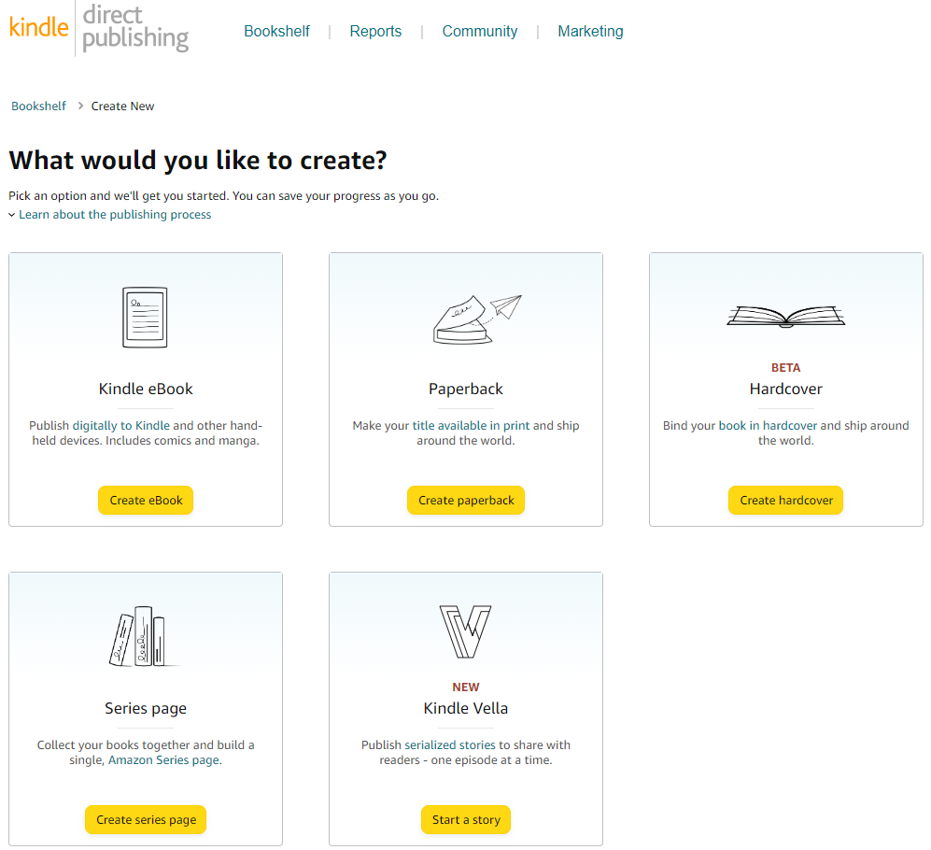
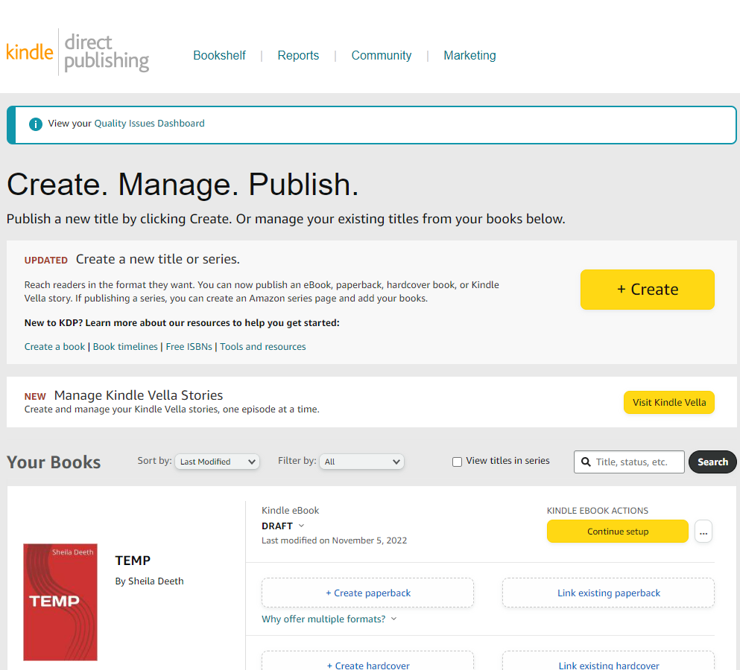




Click “+Create” and choose eBook to start

Slide 27
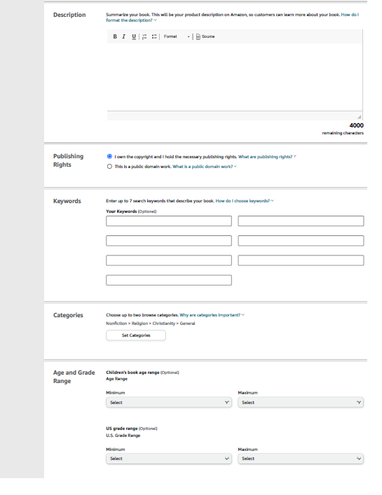
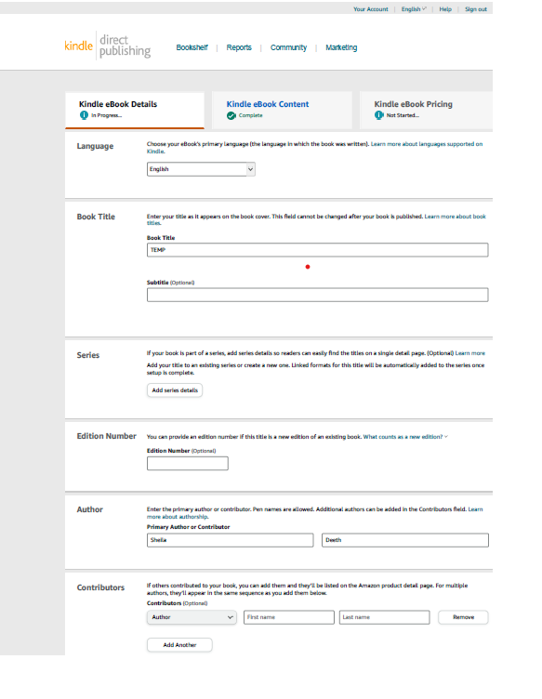
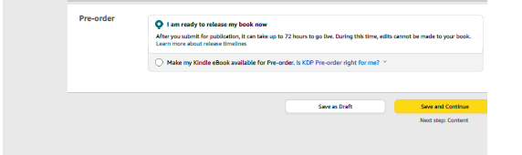
Then fill in the details

Slide 28
Uploading an ebook
Fill in all the basic information. Click “next” or “save and continue,” and then…
Yes
Yes, you are ready to upload your interior file.
Upload
Upload your kpf or epub file.
Wait
Amazon will tell you the file is “processing.”

Slide 29
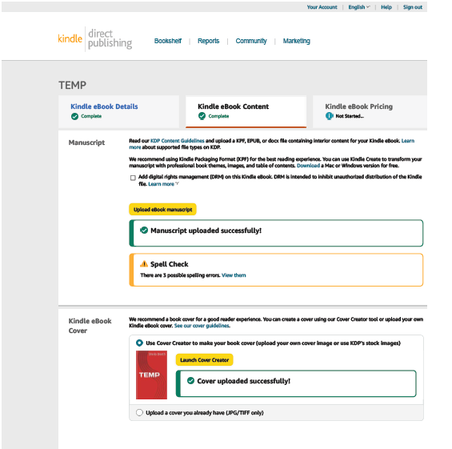
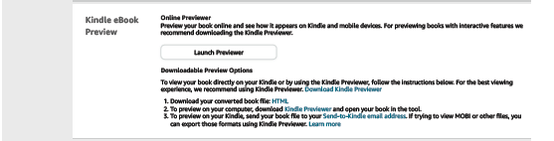
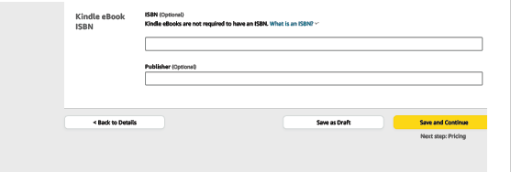
Click “upload manuscript” to upload your kpf or epub (or maybe doc) file. You can upload a new file as often as you want!
Check the spellcheck errors – they might be important! (Then click “back to ebook”)
Upload your cover (jpg file) or launch cover creator. You can change your cover as often as you want!
Don’t forget to preview it… and make edits and reupload if something’s wrong.
You don’t need an ISBN for an ebook. But if you have one, make sure you get the publisher exactly right or they’ll reject it.

Slide 30
Creating an ebook cover
If you have created an image of your cover with the title and author names already added, you can upload this directly. It will be your ebook cover.
Otherwise…
Use Cover Creator
Click on “launch cover creator.”
Design
Choose a design, choose fonts and colors, etc – but note the choices are very limited.
Image
If you have a cover image, upload that to the cover creator. Otherwise choose an image.
Beware
Note, you will want the same design to work for the print book as well.

Slide 31
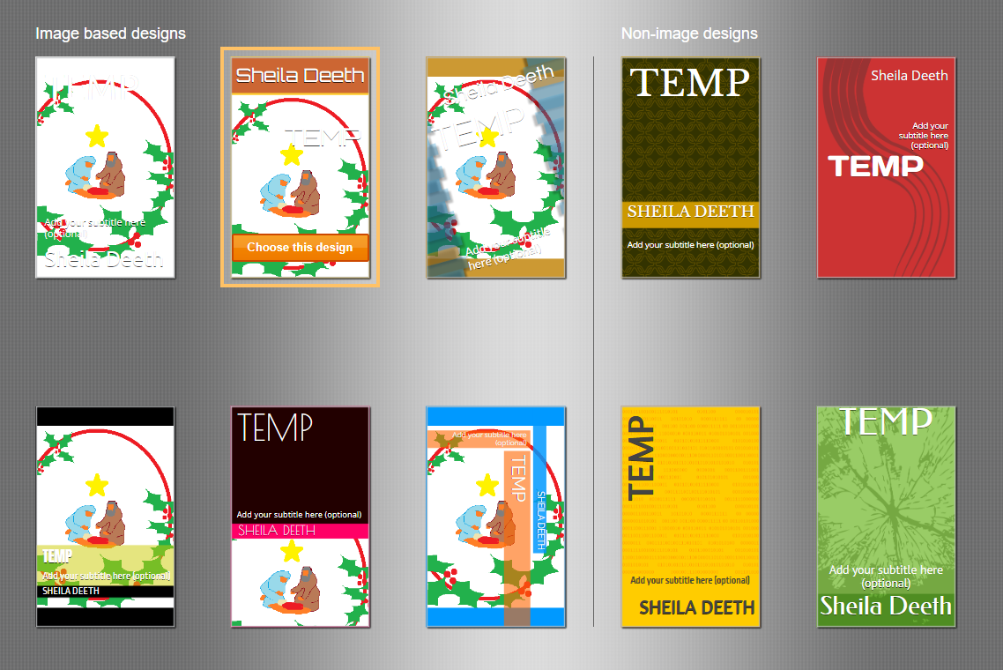
1. Choose a design

Slide 32
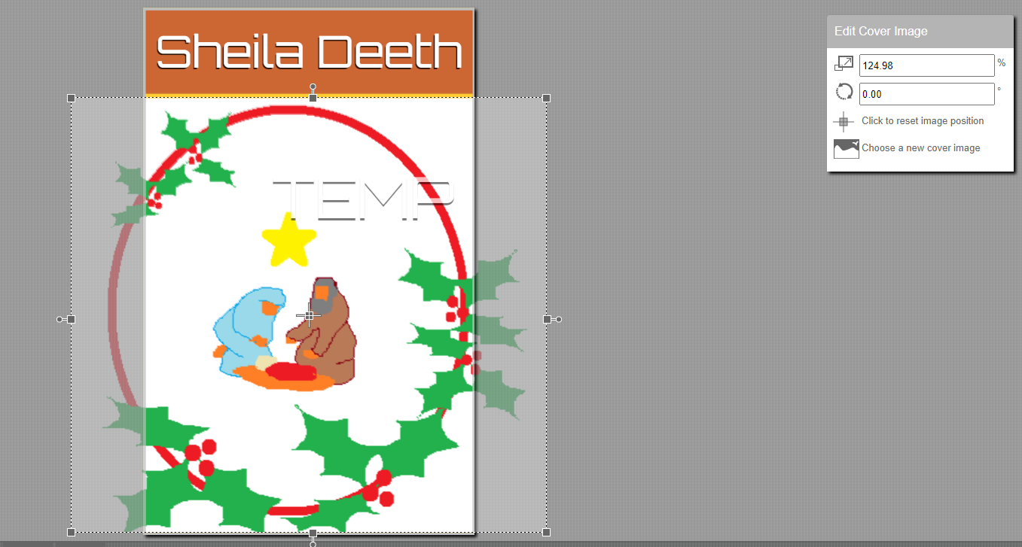
1. Choose a design
Click on the image to change it or choose a new cover image
Click on the title text to change the color or font

Slide 33
Preview Your Book
YOU MUST PREVIEW YOUR BOOK
Amazon provides a great previewer. You can look at how the ebook will look on a phone, a tablet, a kindle… big text, small text… color, black and white… jump between entries in the contents list… check that links within the book really work (e.g. where you linked to “chapter 3” from a paragraph in chapter one)… etc.
You must at least pretend to use the previewer before you approve your book. I strongly recommend you really use it.

Slide 34
A word about ISBNs
Remember, you don’t need an ISBN for an ebook. You might want one if you’re publishing lots of books and have already bought lots of ISBNs. Otherwise, Amazon will give you an ASIN instead.
The ISBN is an international book code, and every PRINT book must have one. Amazon will give you one FREE. Then Amazon will be listed as the publisher, and local bookstores won’t want to buy your book from them (but they’ll buy it from you).
You can buy your own ISBN from Bowker.com, but they are hideously expensive (unless you buy them in blocks of 100 or more). You can’t share them with your best friend or anyone else in the group – once you’ve bought them, you personally are listed as the publisher.
So… FREE, from Amazon, is good! And seriously, your local bookstore will only stock your book if you provide them with copies “on commission” anyway.

Slide 35
Pricing
Amazon will ask you about rights, distribution, price, etc.
You own the rights to your own book.
You can distribute it to lots of countries (though it may not sell well, depending on the language).
Amazon sets minimum prices (so it gets a profit from each sale).
You can choose to receive different percentages, but note, one choice involves their removing the cost of downloading the book before they pay you.
Try to set a price that’s not too cheap (or no one will look) and not to expensive (or no one will buy).

Slide 36
And then the print book!
At this point, Amazon offers you the chance to create the print book. Accept it. They will pre-populate answers to a lot of those questions – title, subtitle, author(s), ages, keywords, etc.
They will ask if you have an ISBN. Otherwise, you can use a FREE amazon one. But… if you want the ISBN to appear inside your book (you probably do), you will have to add it and resave your pdf file NOW, before uploading.
Then worry about the cover.
When you’re ready, upload your pdf file.

Slide 37
Print Book Covers
Print book covers are more complicated. They have a front, a back, and a spine.
If you have already created a pdf cover file, upload it now.
Otherwise, use Amazon’s cover creator.
Amazon will “attempt” to match the cover it made for the ebook. Things to watch for:
Did the image appear in the right place? Sometimes it gets magnified or moved and you might need to edit it – e.g. by putting one copy next to another in the same file and reuploading it as a new image for the print book.
Does the text on the spine look right (and not too big)? Sometimes cover creator gives you spine text that Amazon rejects as too big to print on the spine. So… you just redo it.

Slide 38

Back Cover
Amazon’s cover creator will (probably) give you two areas for text on the back cover, and one space for an image.
We’re going to insert the library’s owl in the image space.
We will put the blurb from our book descriptions onto the back cover as well.
And we will add our thanks to the library, plus information about where to find us.
Amazon’s cover creator leaves a space for the barcode and adds the barcode for you. NOTE, Amazon barcodes don’t include prices.

Slide 39
Preview Your Book
YOU MUST PREVIEW YOUR PRINT BOOK AS WELL
Amazon provides a great previewer. You can see how the cover looks, turn pages, check the headers and footers, make sure chapters appear on the right pages, check the ISBN (if included) is correct…
You must at least pretend to use the previewer before you approve your book. I strongly recommend you really use it. And if you want to be really sure everything worked, order a preview copy through the mail as well – it will have PROOF written across every page, but it will let you know how the colors printed, etc.

Slide 40
Pricing (again)
Amazon will ask you about rights, distribution, etc. (again)
You still own the rights to your own book.
You can still sell it to lots of countries (though it may not sell well, depending on the language). You can also “distribute” it, for sale on Barnes & Noble etc. (though it’s really not likely to help you – they’re not going to buy from a competitor!).
Amazon sets minimum prices (so it gets a profit from each sale), and these are higher if you choose to distribute (so they get a profit from each “wholesale” purchase). Guess why we don’t distribute our anthology!
Try to set a price that’s not too cheap (or no one will look) and not to expensive (or no one will buy).

Slide 41
STEP 5
Advertise your book

Slide 42
What next?
If you don’t already have an amazon author page, create one now!
From your kdp dashboard, go to “marketing” (probably top right tab). (You can try going straight to https://author.amazon.com/. It might work.)
Choose your marketplace (what page are you setting up?) then click on manage.
And now, unless you already have books there (you might, if you’re one of our authors), they’ll want you to help them “find” a book that “belongs” to you.
Then you can add an author bio, link your blog, add a photo, and do other good stuff.
Find the button to “manage” your author page.

Slide 43
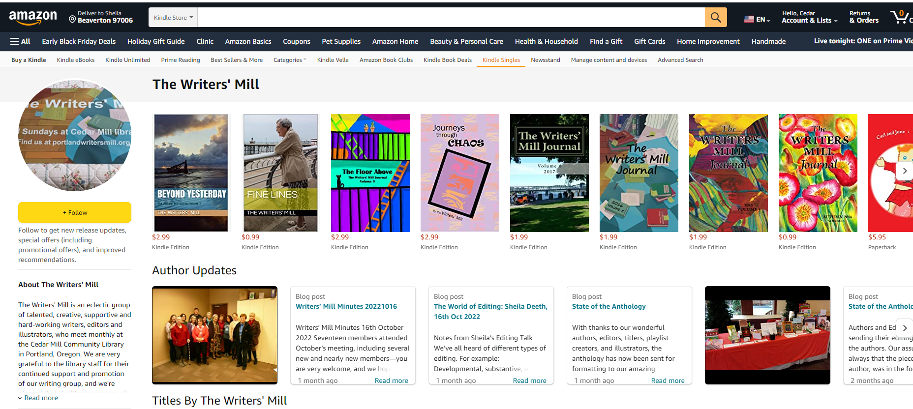
amazon.com/author/portlandwritersmill

Slide 44
“Marketing” takes you to your “Amazon author” page, or to a place where you can create your Amazon author page.
You might need a kdp account if you want to set up an author page. But try going to https://author.amazon.com/ and it might work.

Slide 45
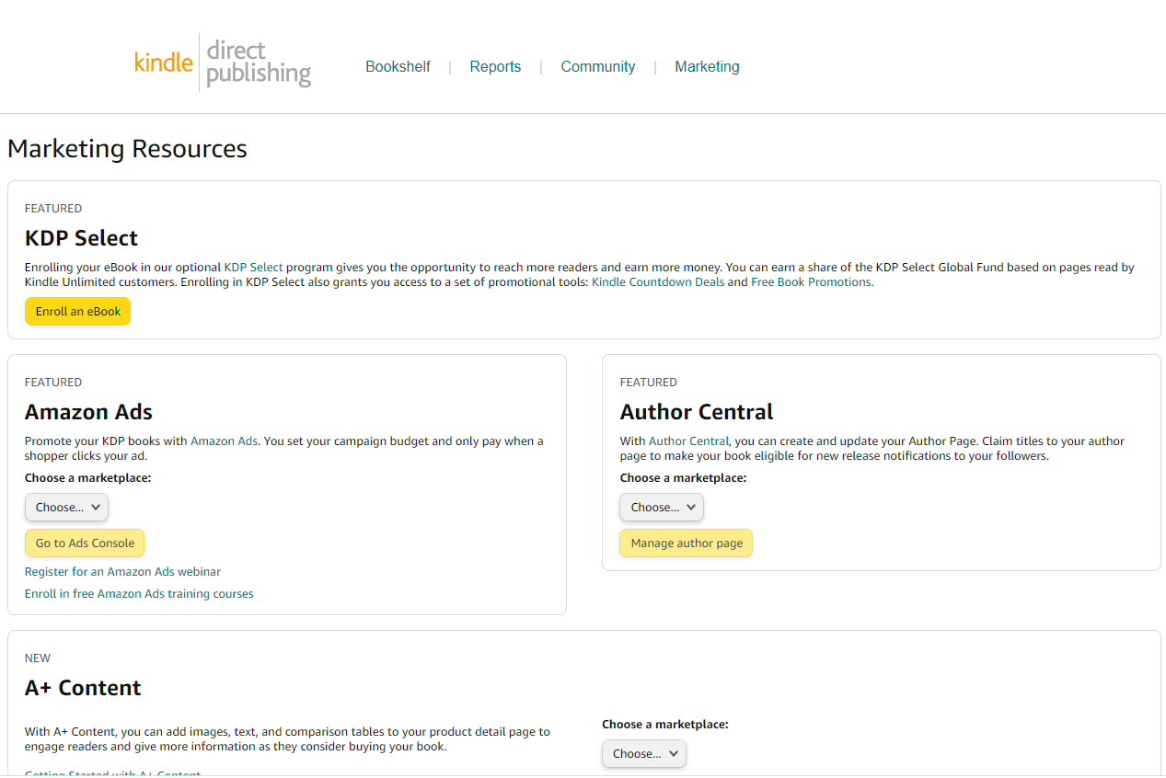

Slide 46
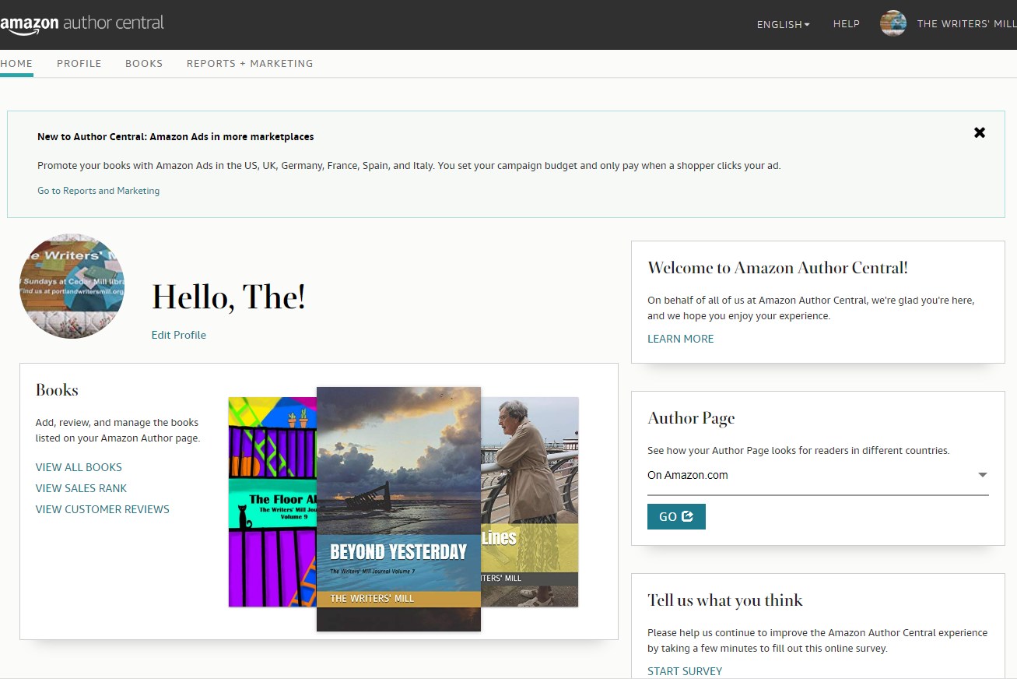

Slide 47
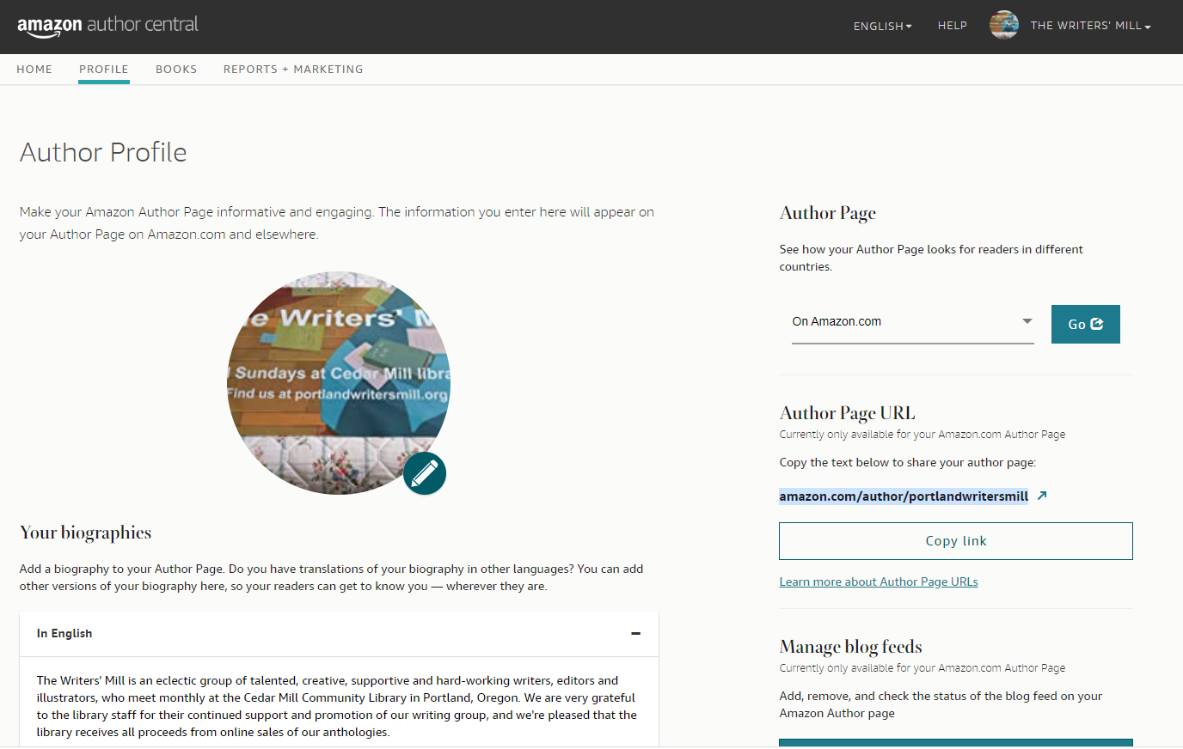

Slide 48

What if we didn’t list you as one of the authors?
Select your book (say, Millworks Framing Life)
When it asks you to select your author name, choose “My name isn’t there.”
Then look for the “contact us” button (wherever they’ve hidden it).
You are contacting them about a book – contact by email.
Give them the book title and ASIN or ISBN
Tell them you are one of the authors
Ask them to give you an author page listing that book.
Then wait. They are usually really, really good about fixing this.

Slide 49
And you are now an author!
With a real book for sale!
Congratulations!

