Slide 1
Writing DETAIL AND
DIaLOGUE TO
TIME AND PLACE
Maryka Biaggio, phd www.marykabiaggio.com
Sign up for newsletter to enter drawing
JANUARY 2023
THE WRITERS MILL

Slide 2
Presentation Goals
Discuss ways to research details for setting, period, and dialogue
Provide guidance on how to bring authenticity to your writing through detail and dialogue

Slide 3
Detail and Dialogue:
Things to Consider
1. What time period are you writing in?
2. Where is your novel taking place—what country and region?
3. What are the educational levels, races/ethnicities, occupations, and socioeconomic classes of your characters?
4. What differences do you want to showcase among your characters?
5. What mood are you trying to create?
Notes:
Place and period are the context, a sort of holding tank, for the characters and their identities. Periods come with different norms and customs, places with customs and legacy. A story set in the American south in 1890 will be very different from one set in New York in 1920.

Slide 4
Researching Details—Near History
Newspaper Articles. Can provide rich detail about events, prices of goods, even ideas for scenes. Newspapers.com is a subscription service.
Diaries and Letters. Can provide information about daily life, habits, and sometimes surprising tidbits.
Census and Vital Records. Can provide information about names of occupations, causes of death.
Period Novels, Nonfiction Books, Movies. Can provide a sense of language, customs, norms, and place.
Notes:
Examples of movies: Fargo by Coen brothers. The Yearling for rural American dialect, Valley Girl for contemporary teenagers, Spike Lee movies set in Brooklyn. Interviews with celebrities from different regions/countries: Dolly Parton, Australian actors.

Slide 5
Researching Language
Online thesaurus and dictionary:
https://www.thesaurus.com
https://www.dictionary.com
Check and compare frequency of use of words and phrases at Google’s Ngram Viewer:
https://books.google.com/ngrams/
Check the etymology of words at
https://www.etymonline.com
Slang Dictionary for colorful language:
http://onlineslangdictionary.com
Notes:
Use thesaurus to find other and less common synonyms. Use Ngram to: confirm words in use during a time period (snazzy, snappy, jazzy), check style (drug store, drugstore), common usage (limousine, limo). Use slang dictionary to find slang for words (shoes).

Slide 6
Researching Details—
Distant History or Unfamiliar Lands
Diaries and Letters. Can provide information about daily life, habits, and sometimes surprising tidbits.
Nonfiction books. Can provide information about occupations, transportation, foods, etc.
Travel and Local Tours. Can foster a deep understanding of place and its history.
Period Novels or Nonfiction Books. Can provide a sense of language, customs, norms, and place.

Slide 7
Newspaper Articles
THE BROOKLYN STANDARD UNION
January 23, 1924
GIRL BANDIT ADDS ANOTHER
TO LONG LIST OF HOLDUPS
The elusive girl bandit—she of the shorn locks and pretty face—made another move last night in the game of checkers she has been playing with the police for a month now.
Accompanied by her steady companion, the mysterious, tall young man, she went to a grocery store at 241 Albany Avenue, held up the proprietor and a woman customer who happened in, and then escaped with $55 in cash.
The girl failed to leave behind one of the mocking notes as in other robberies. All attempts to give a humorous touch to her aggressions against the law were abandoned in this instance. She was just a bandit, pure and simple.

Slide 8
Diaries and Letters
November 14, 1928
Dear Helen,
At the risk of subjecting myself to further complaints (for you seem bent on misapprehending everything I say and rattling off claims to our friends about my “improvident ways”), I must question your decision to embark on this journey. It forces us to communicate at long and uncertain distances and intervals. It requires funds that are needed for more basic exigencies, such as the maintenance of the house and the girls’ general comfort. I ask that you make this a short and hopefully rejuvenating vacation rather than the crack-brained expedition you seem set on.

Slide 9
Period Novels
Sister Carrie (1900), Theodore Dreiser
Theater of all genres—vaudeville, Shakespeare, musicals with choruses of scantily clad dancing girls, melodramas, drawing-room comedies—was popular after the Civil War.
Shops: florist, furriers, haberdashers, confectioners
Masher—one whose dress or manners are calculated to elicit admiration of susceptible women.
Elevator man
Ladies rustled by in dresses of stiff cloth, rouged and powdered cheeks and lips, scented hair
Prince Albert coat (a fine man’s coat)
Hornswaggled
Coal heavers with great loads to shovel
Blinking lines of gas-lamps

Slide 10
Finding Period Novels
Website “The Books of the Century” was compiled by Daniel Immarwahr at UC Berkeley and lists top sellers of the 20th Century: https://www.ocf.berkeley.edu/%7Eimmer/booksmain
Wikipedia has a list of novels published in the 1800s at https://en.wikipedia.org/wiki/Category:1800s_novels
To find novels about different places, try Goodreads →Browse →Lists and search the lists for places.
Notes:
For instance, when I searched for Tahiti I found 4 lists about Pacific Islands and the South Pacific.

Slide 11
Utilizing Nonfiction Books
Sin in the Second City, Herbert Asbury
Druggists stocked $1 bottles of Hibbard’s Herb Extract, touted for itching, burning, and smarting skin and “female weakness”
Quack doctors
Penny arcades and nickel theaters
Puddle-deep rugs and gilded spittoons
Brougham
Sporting house

Slide 12
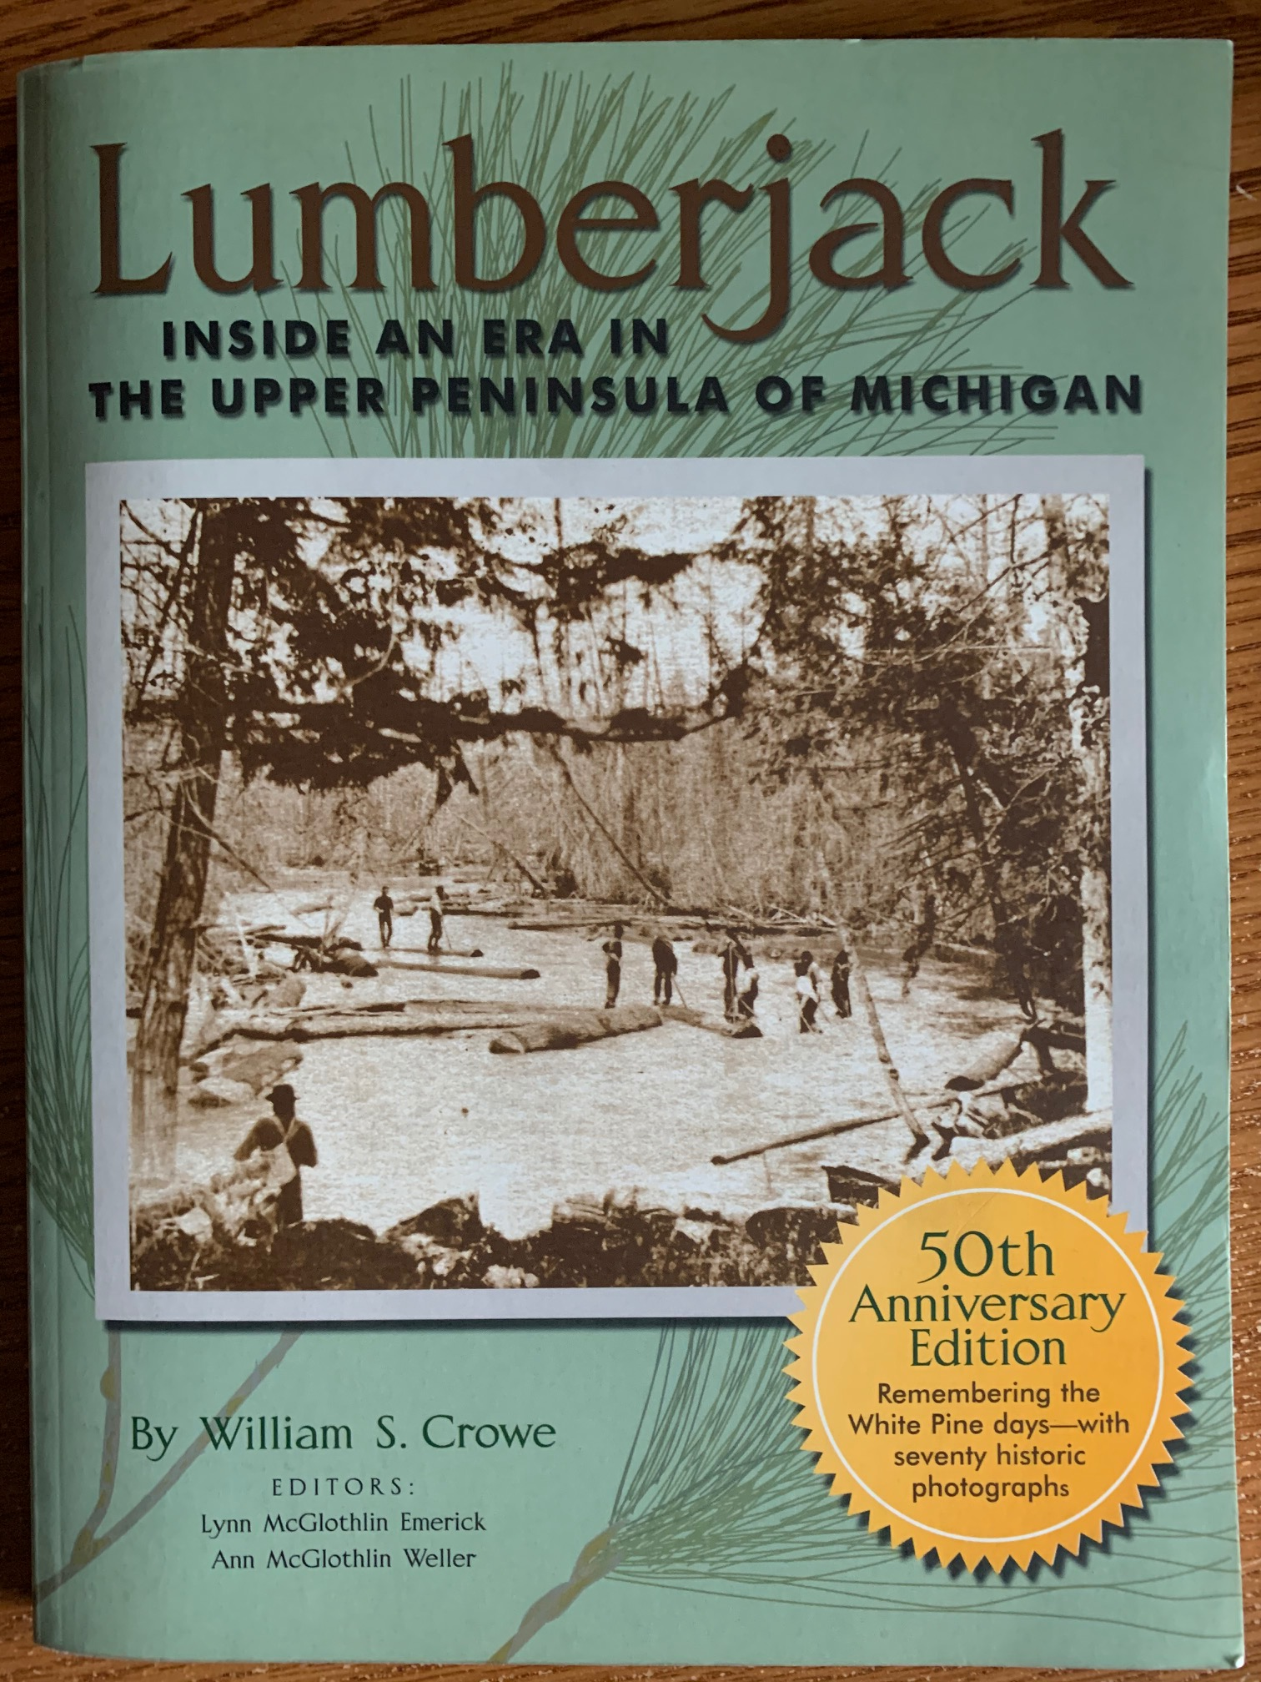
Libraries and Librarians
Go to the stacks and look for books that may
be helpful.
Use librarians to research
off-the-beaten path details.
Notes:
When I needed to know if there was an ice rink in New Haven, CT, in 1920 I turned to a librarian there.

Slide 13
Deciding What Details to Include
Do include:
  Details that readers expect for your genre
  Details that show important settings for the story
  Details that paint a scene that matches novel’s mood/feelings
  Details that enlighten character’s perspective
  Details that highlight story theme/big idea
Refer to your compendium
  Look for places to insert details: greetings, heated talk, dialogue or description
Do not include:
  Everything you’ve learned about the setting or period
  Details that bog down the narrative
  Business-as-usual details

Slide 14
The Purposes of Dialogue
Examples from a detective novel:
  Show character or relationships—“A girl wants to see you. She’s a knockout.” “Shoo her in, darling.”
  Provide background—“I inquired at the hotel about a reliable private detective.”
  Convey/escalate conflict or threat—“I’m deathly afraid of him, of what he might do.”
  Suggest subtext—“More than idle curiosity prompted my question.”
Notes:
QUIZ 1. This is from a hard-boiled detective novel set in San Francisco, published in 1930.

Slide 15
Dialogue Conventions
Give each character their own paragraph; some white space is appealing.
Put at beginning or end of paragraph.
Use “double quotes” for dialogue (unless otherwise recommended by publisher).
Internal dialogue can be set off by “she thought” tag, by italics, or by context.

Slide 16
Dialogue Do’s
Ideally, use to accomplish more than one thing.
Keep it short and concise.
Give individuals different styles of speech.
Push to deepen dialogue—writers can revise dialogue, real speakers can’t.
Read dialogue aloud to check for authenticity.
Use contractions freely.

Slide 17
Dialogue Don’ts
Avoid obvious dialect, e.g., goin’ fishin’. Instead, focus on word choice or cues.
Don’t include mundane dialogue—unless you want to highlight the mundane.
Don’t overuse dialogue to convey information.
Avoid on-the-nose dialogue. Instead, pay attention to subtext.
Notes:
Their Eyes Were Watching God by Zora Neale Hurston and other older novels use a lot of dialect.

Slide 18
Subtext in Dialogue
¹
Example from an American novelist:
I just want to live simply and pay attention to what’s happening each day. And come sleep with you at night.
It turns out we’re not finished with changes and excitements. And not all dried up in body and spirit.
And we’re not even doing what people think we’re doing.
Do you want to? Addie said
That’s entirely up to you.
Notes:
QUIZ 2. Novel set in a small town in the fictional county Holt in eastern Colorado around the 1990s. Characters are Addie and Louis.

Slide 19
Using Dialogue Tags
“He/she said/asked” are the most straightforward dialogue tag and are almost invisible. This should be primary tag used.
Don’t use “he/she said/asked” for every line of speech. Usually only needed every few lines.
Action tags can provide a picture of speaker’s behavior.
Internal dialogue can show what speaker is thinking and not saying.

Slide 20
Telling Dialogue 1
Example—a classic American novel:
“A saucy manner does not go down with me.”
“I will not be bullied.”
“Earlier tonight I gave some thought to stealing a kiss from you, though you are very young, and sick and unattractive to boot, but now I am of a mind to give you five or six good licks with my belt.”
“One would be as unpleasant as the other.”
Notes:
QUIZ 3. Novel set in 1870s, Characters here are young girl named Mattie and a Texas Ranger.

Slide 21
Telling Dialogue 2
Condensed example—a well-known American author:
“What you be dig for? Worm grub?”
“We’re cultivating the soil, sister.”
My father mopped his brow again and launched into the parable of the one mustard seed falling on a barren place, and the other one on good soil.
Mama Tataba seemed not to listen. “You got to be make hills.”
He said at last. “I’ve been tending the soil ever since I could walk behind my father.”
Notes:
QUIZ 4. Novel set in Belgian Congo 1959. Characters here a missionary and African woman.

Slide 22
Telling Dialogue 3
Condensed example—a prolific American author:
“I have plans for you, Norma Jean. For us,”
Gladys said.
Norma Jean’s piano lessons continued sporadically. And she had occasional voice lessons.
Miss Flynn told Gladys, “Your little girl has a sweet, sincere personality. But right now”—Jess Flynn spoke softly, so Norma Jean might not hear—”she really has no voice at all.”
Gladys said, “She will.”
Notes:
QUIZ 5. Novel about Marilyn Monroe by a prolific American novelist.

Slide 23
Dialogue For Time and Place
Use details specific to the time/place.
  “Let us make the fishmonger our last stop.”
Signal a different time period with formal or anachronistic speech.
  “Of the many people who thronged my life, I counted him the most engaging.”
Use jargon/sayings of time/place.
  “God’s teeth, he’s foiled us again.”

Slide 24
Maryka Biaggio, PhD
QUESTIONS?

Slide 25
Maryka Biaggio, PhD
Author of:
  Parlor Games (Doubleday)
  Eden Waits (Sunbury Press)
  The Point of Vanishing (Sunbury Press)
  The Model Spy (Sunbury Press)
Sign up for my newsletter at my website: www.marykabiaggio.com

