Slide 1

Publish or Perish
or just Put your words out there?

Slide 2
What counts as Published anyway?
Book
Zine
Article
Poem
Picture
And what counts as Published-ish?

Slide 3
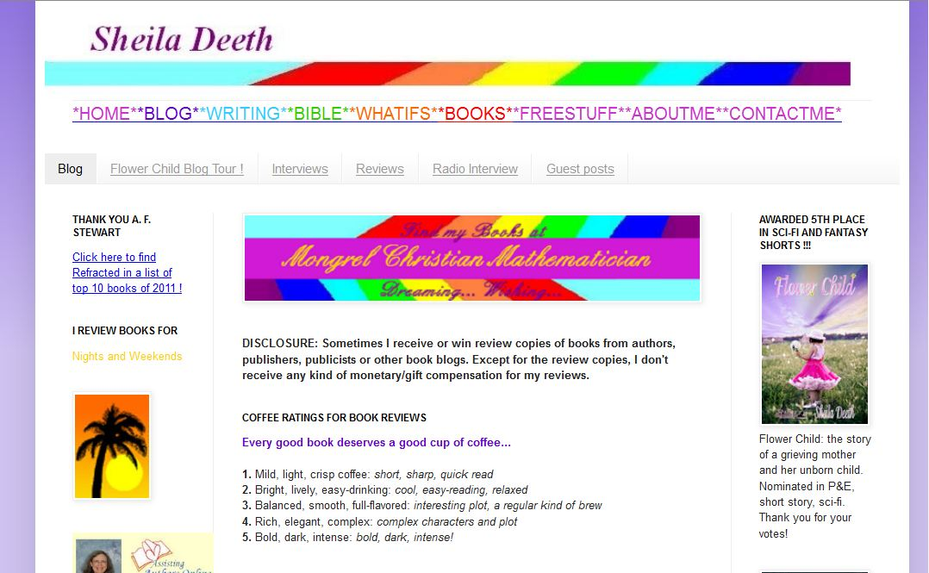
Start a blog –
IT’S PUBLISHED
(and publishers will care)

Slide 4
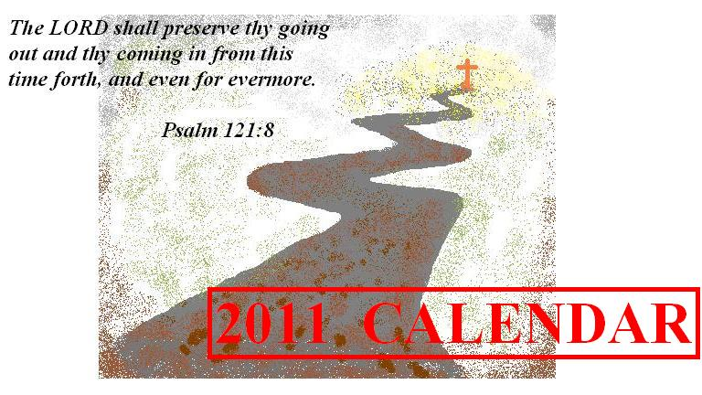
Create a calendar – choose the words and images –
IT’S PUBLISHED-ish

Slide 5
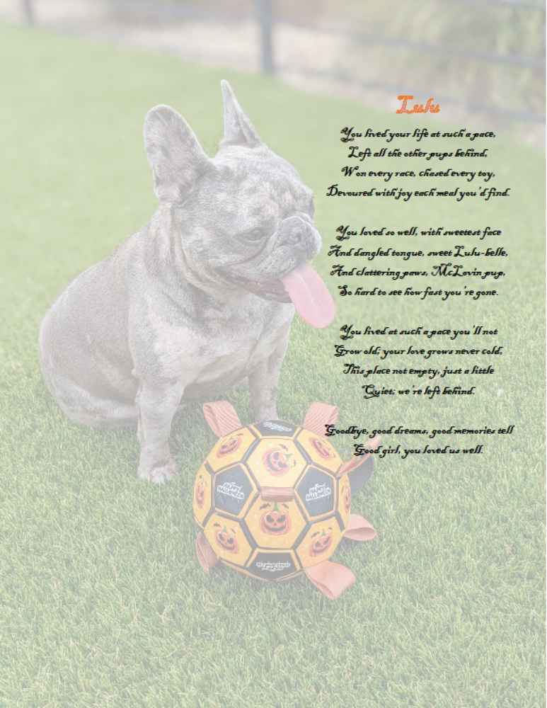
Write a poem, illustrate it, and hang it on your wall –
IT’S PUBLISHEDish!
You put your words out there if you just send it in an email too, or share it with a friend, but it’s not published until it’s publicly available, hanging on the wall in the town hall.

Slide 6
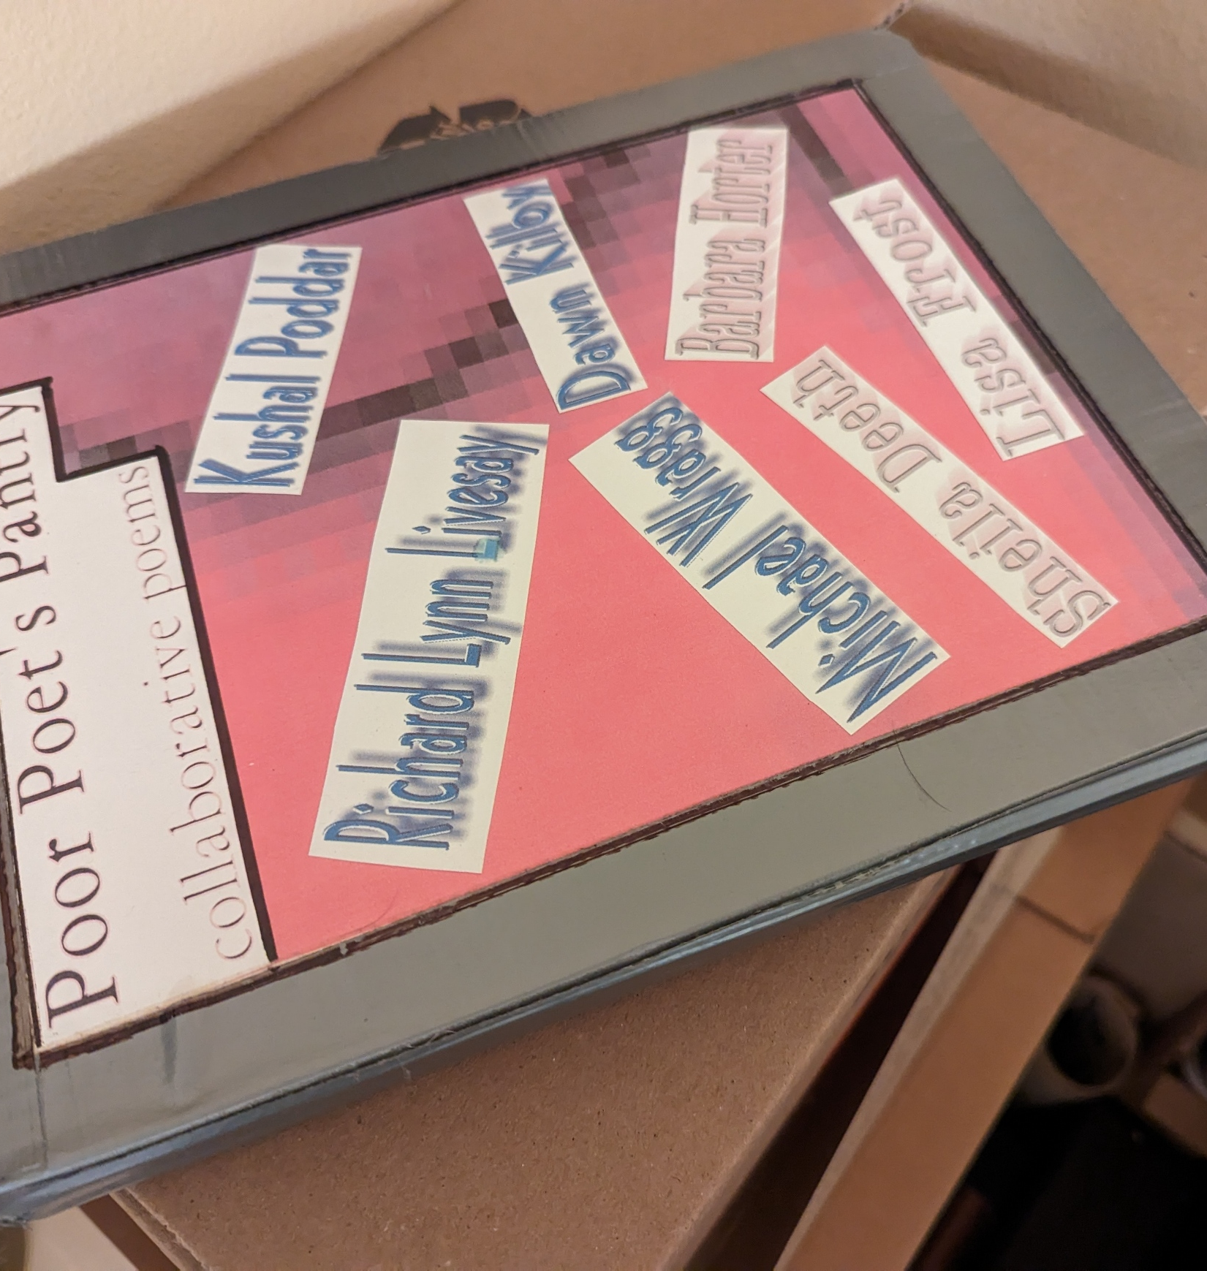
Stick it together with Duct-Tape
IT’S PUBLISHEDish
(He only made 12 copies)

Slide 7
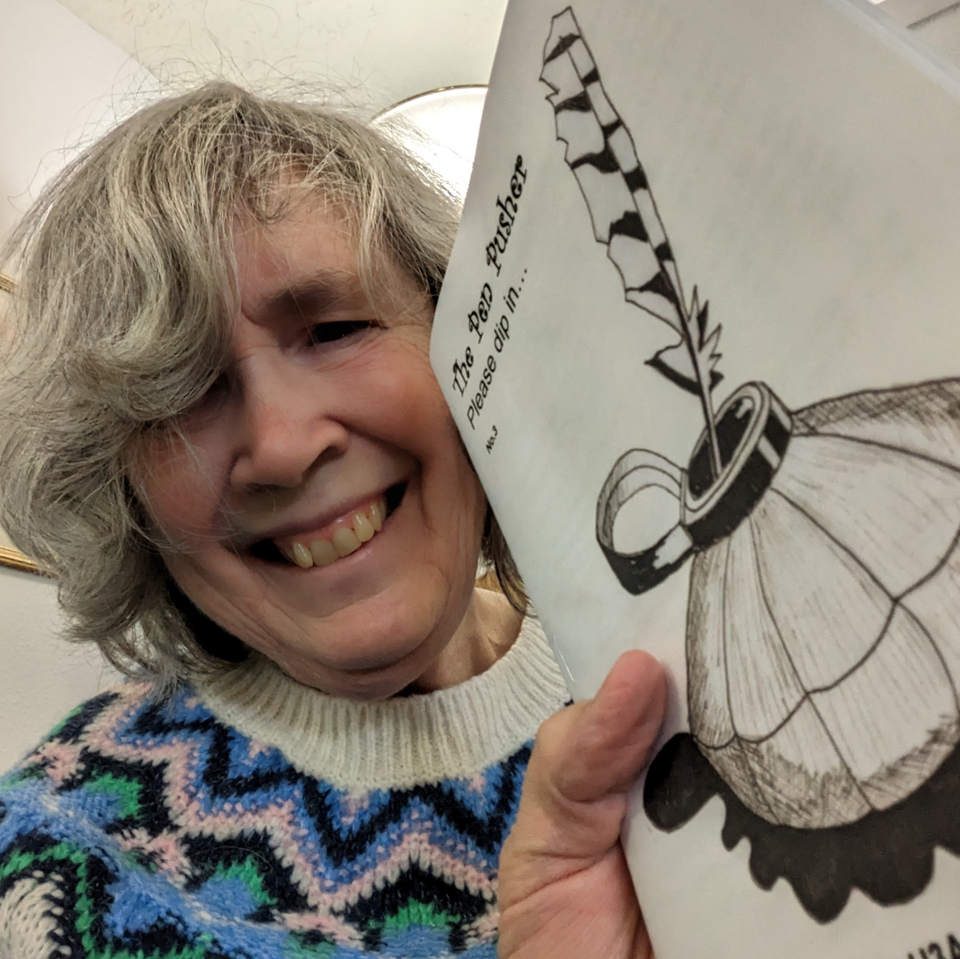
Staple some pages together and make a Zine –
IT’S PUBLISHED as soon as you sell it!
(poems, stories, essays, diary… whatever! If it’s publicly available, publishers will call it published.)

Slide 8
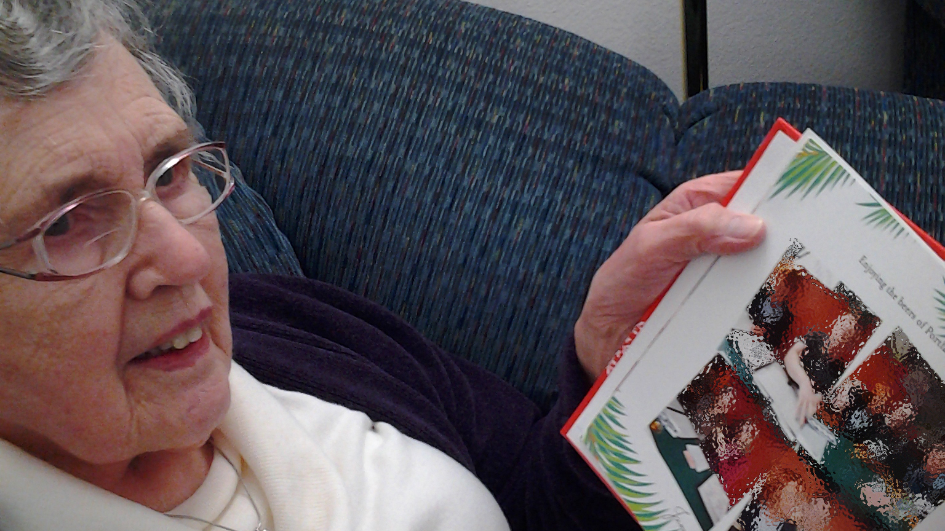
Make a Photo Album, with captions, and give it to someone as a gift –
IT’S PUBLISHEDish
(and it’s private)

Slide 9
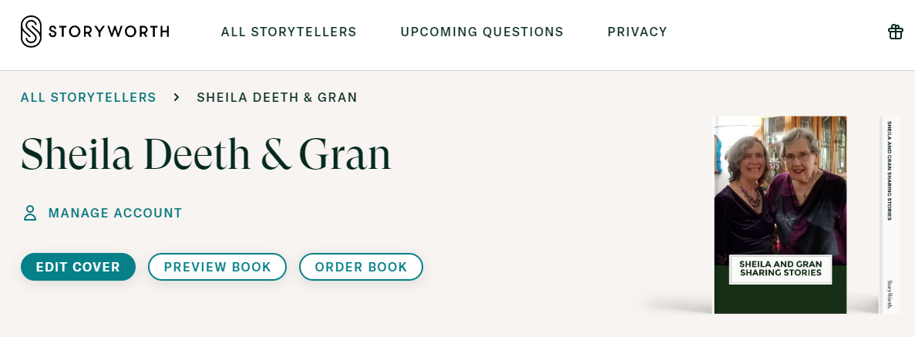
Family History
Storyworth.com
We’ve bought our copies so it’s PUBLISHEDish

Slide 10
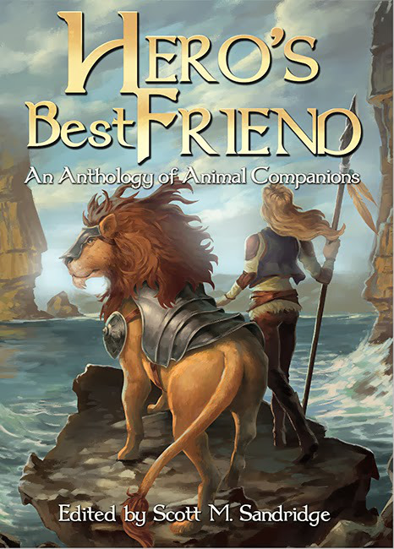
Enter a contest and win, or submit a piece to an anthology and get it accepted –
IT’S PUBLISHED
Definitely published

Slide 11
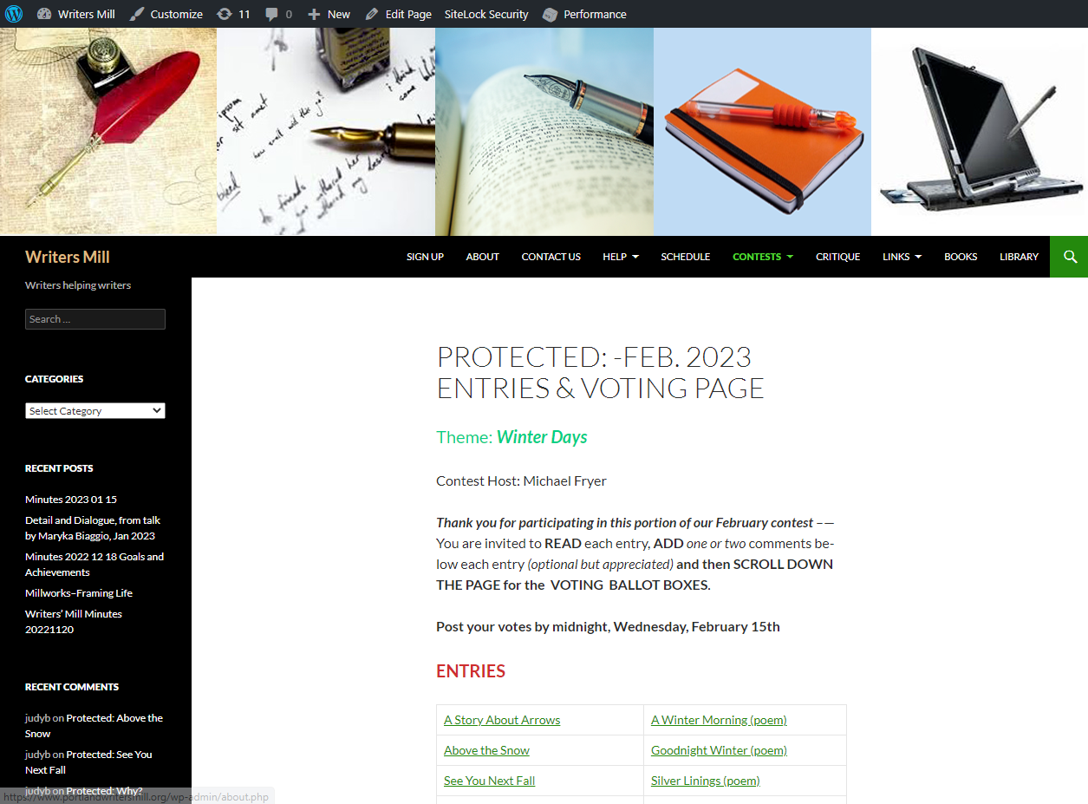
Enter a Writers’ Mill Contest – it’s not “published” but
IT’S PUBLISHEDish
(Publishers will not consider it published because our site is password protected.)

Slide 12
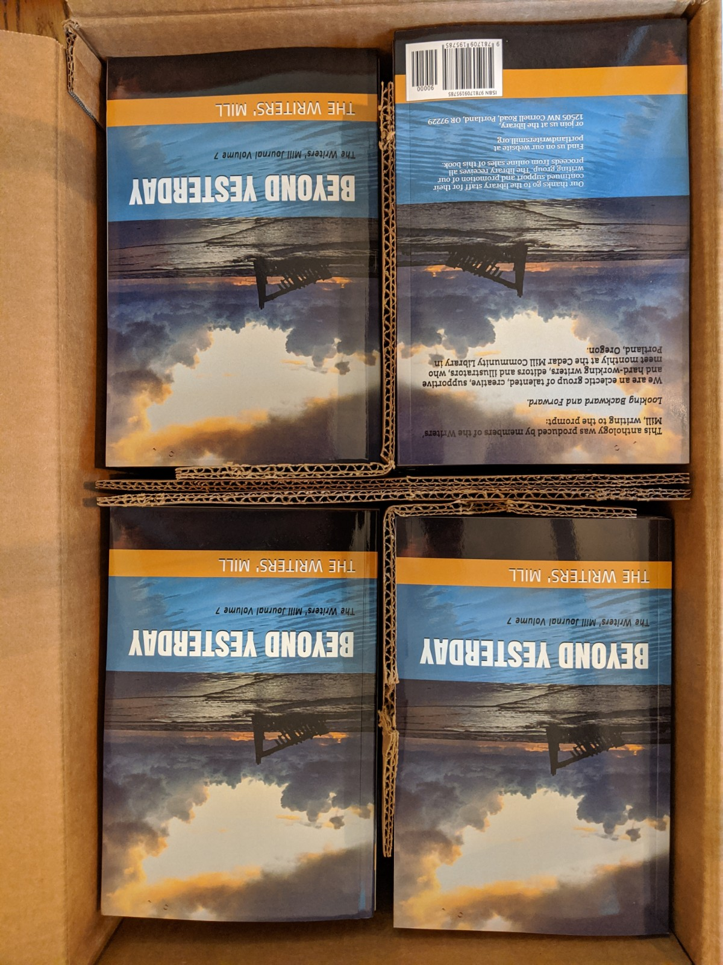
Submit something for
the Writers’ Mill Anthology
IT’S PUBLISHED!
(No longer password protected, therefore definitely published)

Slide 13
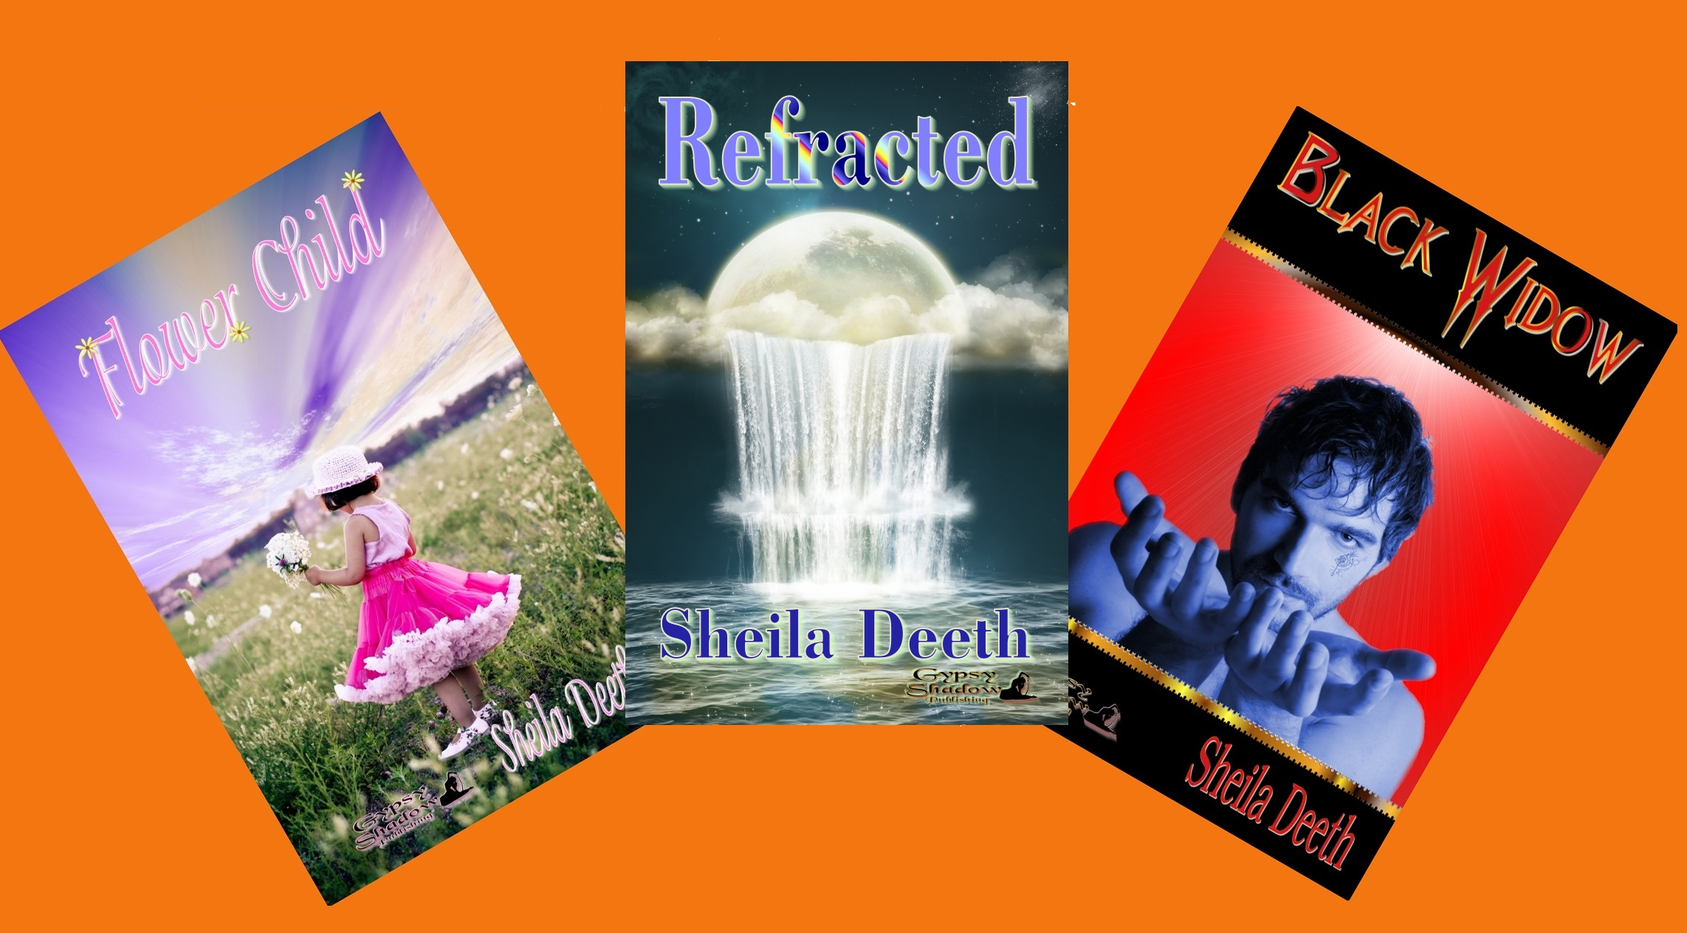
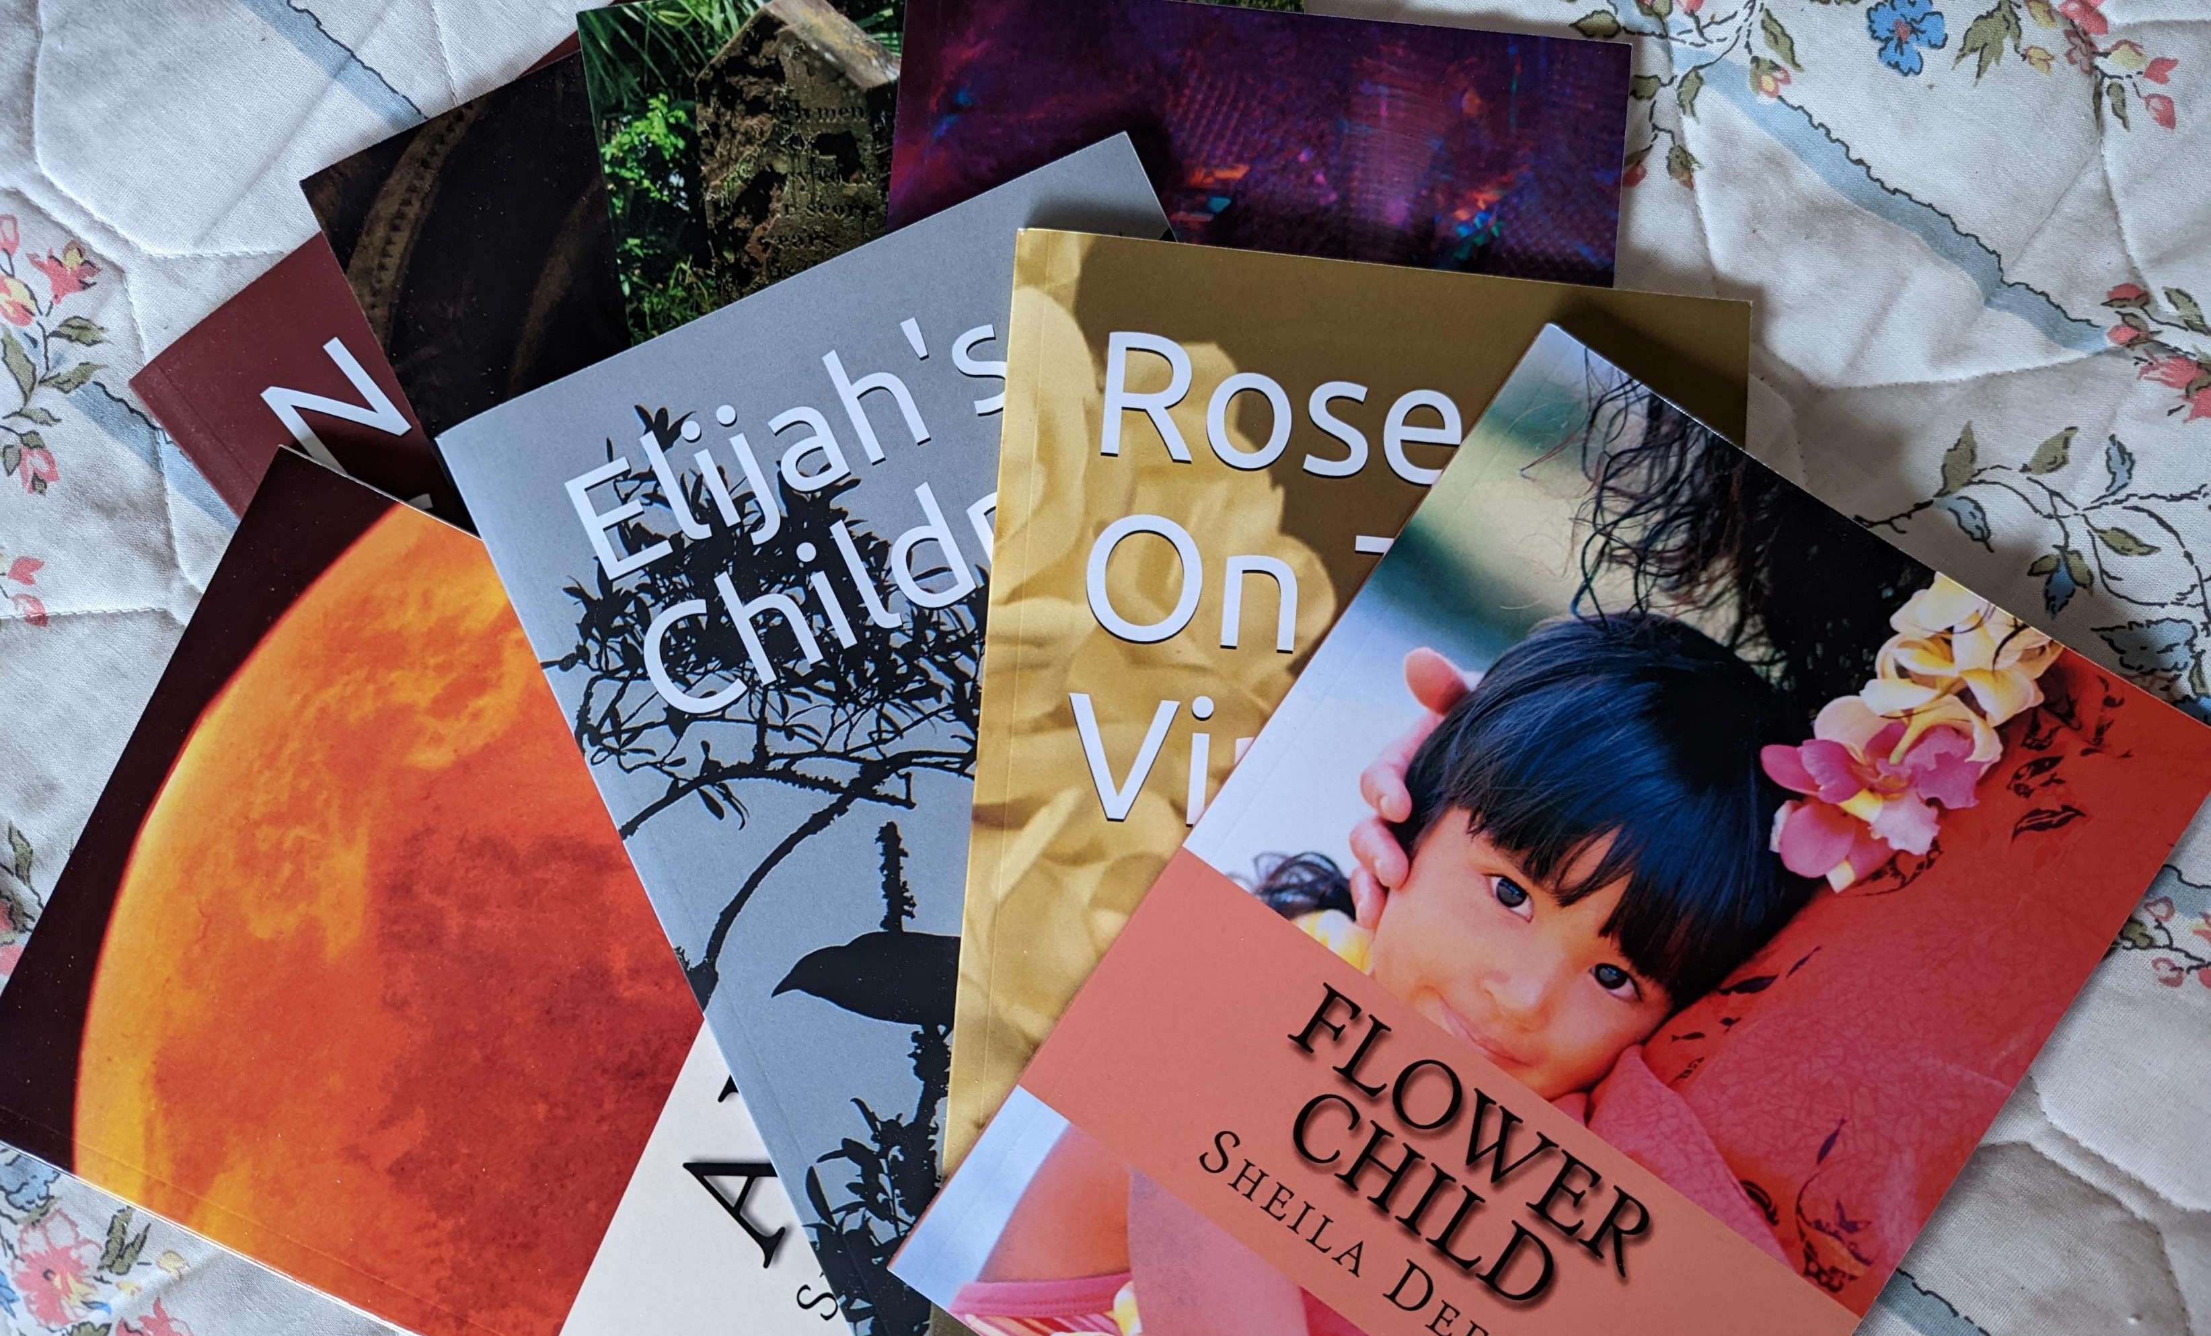
Ebooks
or Print Books –
If it’s for sale,
IT’S PUBLISHED

Slide 14
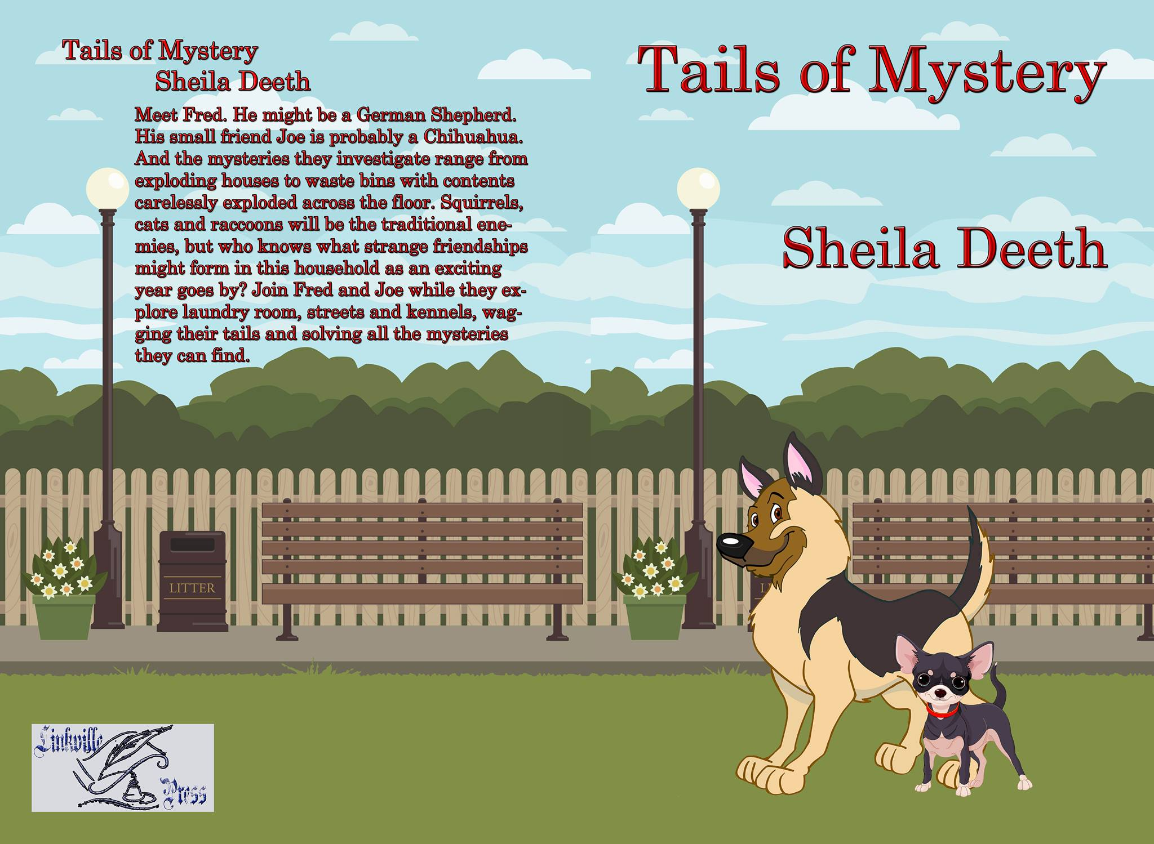
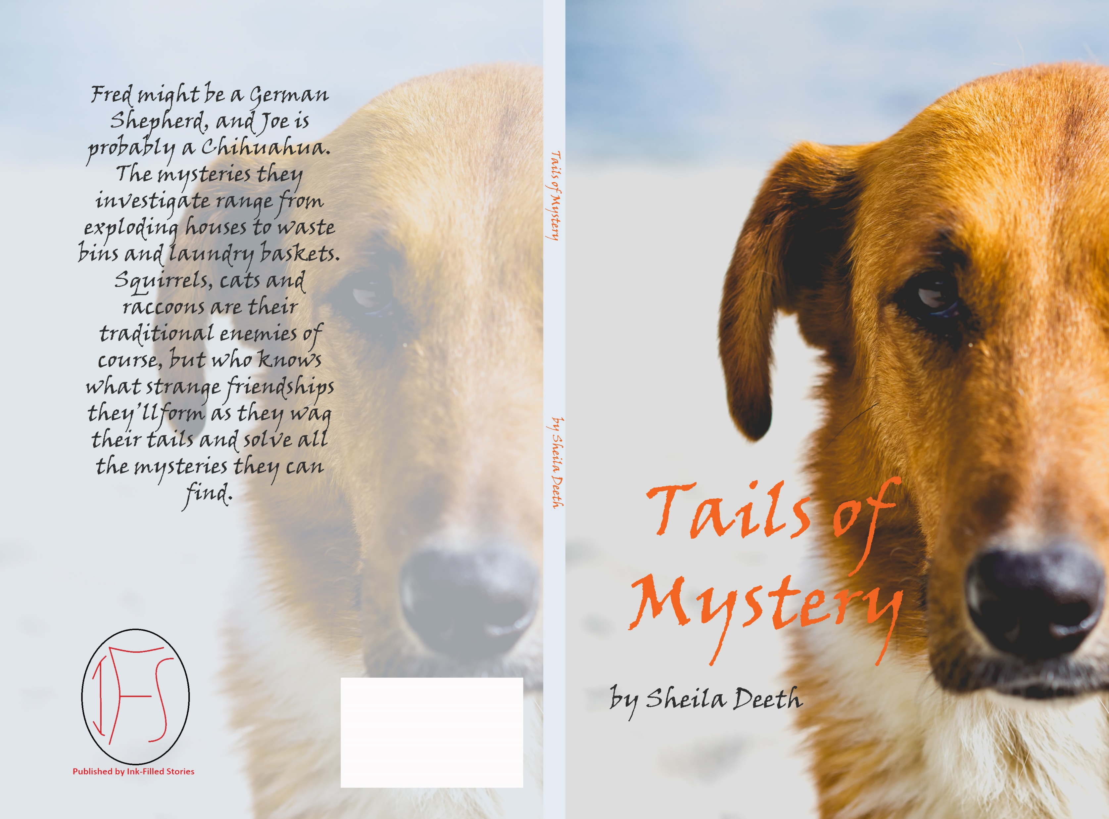
Find a Publisher
or Self Publish –
even if you never make any sales
IT’S PUBLISHED as soon as it’s for sale!

Slide 15
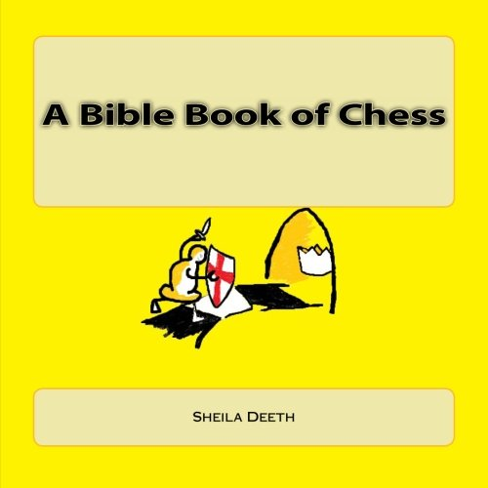
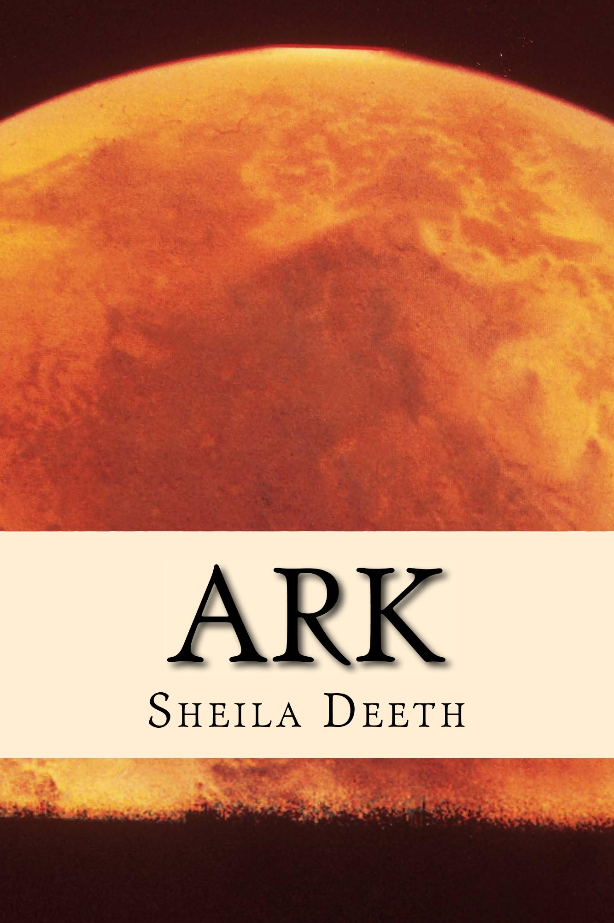
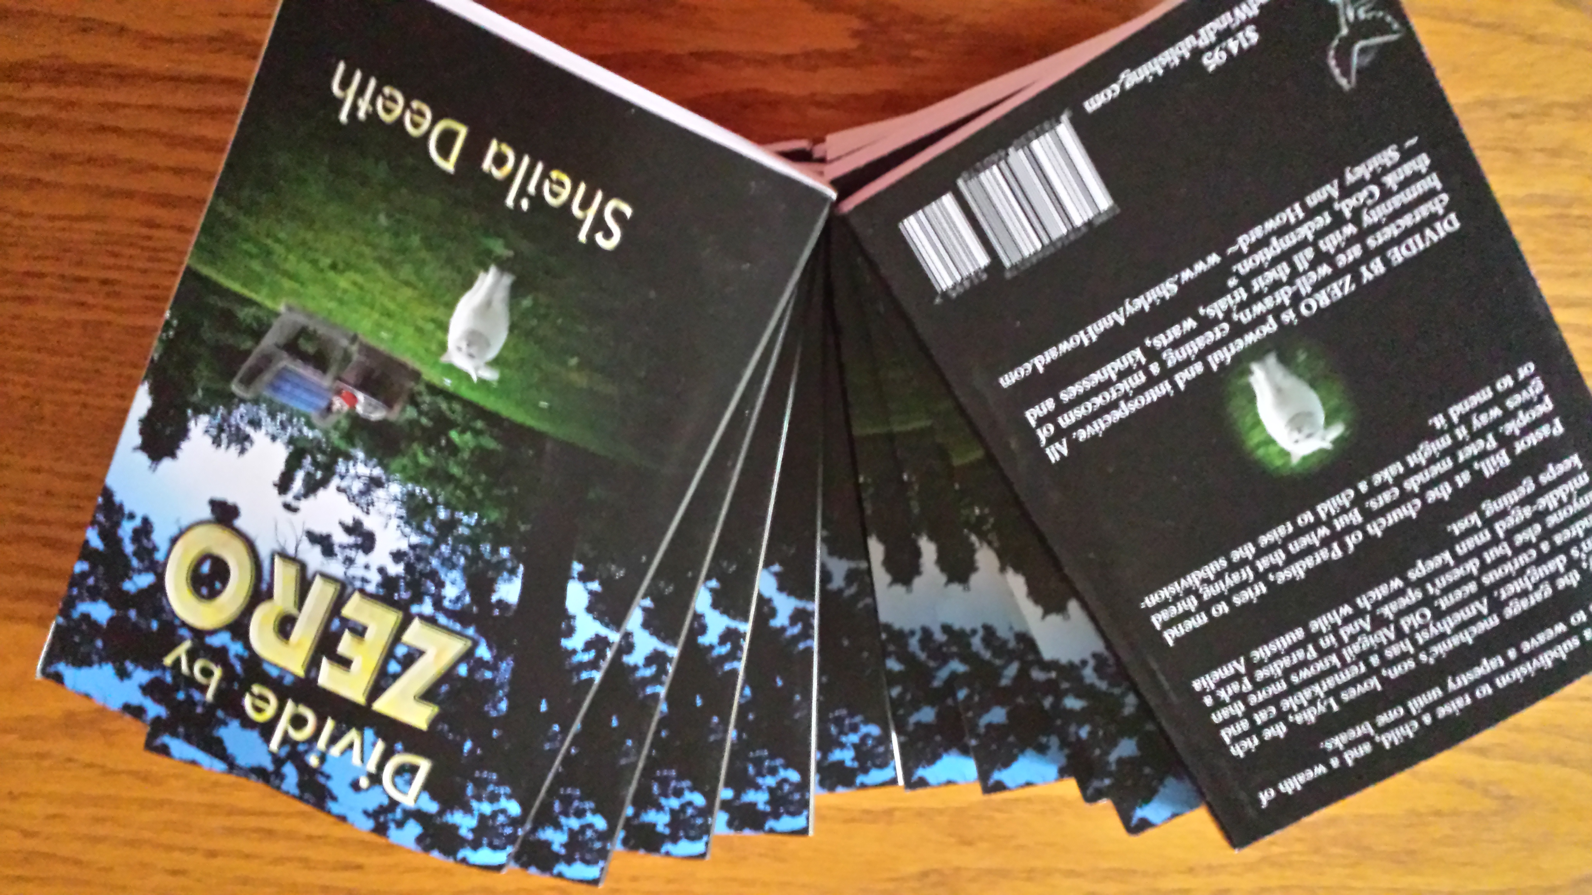
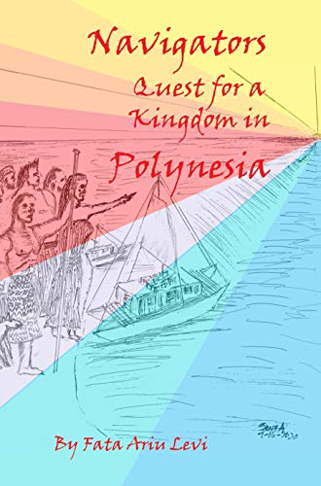
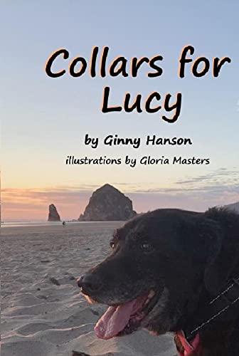

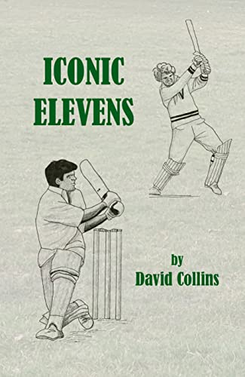
Picture Book, Poetry Book, History Book, Cricket Book, Chess Book, Novels, Novellas and More –
PUBLISHED

Slide 16

Or just write a letter to a friend… It’s not published, but
IT’S PUBLISHEDish!
(email counts too!)

Slide 17

Three Questions:
What’s your name?
What sort of “putting your words out there” do you most aspire to at this moment?
Are you published, or published-ish? And

Slide 18
1) How do you find places to Send Your Writing?
Authors Publish https://authorspublish.com/
Poets and Writers https://www.pw.org/
Oregon Humanities call for submissions: http://oregonhumanities.org/rll/magazine/call-for-submissions/
Tualatin Valley Creates https://tvcreates.org/
Writers’ Market (you might have to subscribe) https://writersmarket.com/
Anthologies? Read one that you like, then look for them online and submit to the next edition
Does anyone use any online submission tools (to find where to submit, keep track of submissions ect)?
  Submissiongrinder https://thegrinder.diabolicalplots.com/
  Submittable https://www.submittable.com/solutions/publishing-and-journals/
  Duotrope https://duotrope.com/promo.aspx
  Querytracker https://querytracker.net/
Notes:
Judy, Karin

Slide 19
2) How do You Find an Agent or Publisher?
Conferences? Willamette Writers (https://willamettewriters.org/) conference (spendy but great)
Read the back of a similar book, write proposal, submit…
check out publishers online? https://querytracker.net/
Follow them online? Write reviews for them? Friend them on facebook? Exchange comments?
How to check a publisher is legit?
  https://www.facebook.com/prededitors/
  https://writerbeware.blog/
  https://www.allianceindependentauthors.org/ (but you have to pay to belong)
Notes:
Jean, Zita, Jim, Sheila

Slide 20
3) How do you Find an Editor?
https://www.fiverr.com/
https://indigoediting.com/
Northwest Editors Guild at https://www.edsguild.org/ for Northwest editors
Facebook, Goodreads… – meet people, see recommendations
Might need more than one editor
More editing after you get the contract – might give advice on avoiding copyright problems
Join an organization and look on their website
  Willamette Writers https://willamettewriters.org/
  NIWA https://www.niwawriters.com/
  Alliance of Independent Authors https://www.allianceindependentauthors.org/
Notes:
Jean, Jim

Slide 21
4) What if you haven’t got an Editor?
https://www.grammarly.com/ (free)
https://prowritingaid.com/ (“Grammarly on steroids”?)
https://hemingwayapp.com/
New Editor tool in Word on the Review tab, and Excel to keep track of haircolor etc.
Read aloud – Word can do that too!
Read backwards…
Look for repeated words – we all have our favorites: so, but, and, …
Join a critique group – writers helping writers!
Notes:
Jean, Jim, Sheila

Slide 22
5) How Long is a Book?
Picture book 1,000 words
Short story 5,000 words
YA/Middle grade 50,000 words
Novella 30,000 words
Novel 70,000 words
Historical novel 90,000 words
Epic 100,000 words
Notes:
Jean, Ginny, Meg, Jim, Sheila, Zita

Slide 23
6) How do you write about Real People?
Memoir – there are some legal guidelines
  better to write about people who are dead,
  but descendants might have concerns
Family history – maybe let people read it before it’s published
Fictionalize it
General history
  “Based on” means it should all be true, but
  “Inspired by” means you can use your imagination
  “Fictionalized” means none of it has to be entirely true
Notes:
Meg, Zita, Mum, Jim

Slide 24
7) Have you ever written in collaboration with another author? Or been a Ghost-Writer?
Ghostwriting?
  Sometimes editing turns into something close to ghost-writing
  Jim worked with someone to help/and or ghost-write their story
  https://storyterrace.com/ – you can pay a professional to help you write your memoir or
  Team up with someone else in a group?
Collaboration? It’s not easy matching writing routines and styles
  Maybe alternating chapters in a novel, or alternating stanzas in a poem
  Could try having one author write one character’s pov and another author write another’s.
Could be a fun exercise for a contest sometime?
Notes:
Jim, Karin, Sheila

Slide 25
8) What about series?
How often should new books come out? Look at dates on other people’s series
  How long does it take to write a book? 13 years or more – how long is a piece of string?
  How many do you have to have written to sell the series? Sell one, but have more than one written
Do the characters have to change and grow older? Look at other people’s series in your genre
How do you keep track of details?
  Scrivener https://www.literatureandlatte.com/scrivener/overview
  Snowflake method https://www.advancedfictionwriting.com/articles/snowflake-method/
  Campfire https://www.campfirewriting.com/
  Liquid storybinder https://www.blackobelisksoftware.com/
  Word Anvil https://www.worldanvil.com/
Notes:
Judy? Sheila

Slide 26
9) What happens after you get an Offer?
Timeline to publication? You might hear nothing for a year or more
  What if it’s taking too long? Be patient, but make sure the publisher is still publishing.
Editing process?
  What if you hate their edits? Meeting face to face (zoom) and talking to editor as a person helps you realize they just want to help. Might not have to accept all their edits
Book covers? You can’t decide how it looks, but you can have input
Advertising material?
  https://www.vistaprint.com/, https://gotprint.com/ or make your own advertising stuff and print locally
Getting paid? Hope for the best.
Notes:
Jean, Sheila, Zita

Slide 27
10) What about Copyrights, First Publication Rights, eBook Rights… and Lefts?
If you write a blog or content for a website, that is published.
    Most publishers want “first publication rights”
    Some are willing to accept “exclusive rights” (not available elsewhere) and might republish something if you remove it from your blog
How do you protect yourself when you share your work?
Your copyright is yours as soon as you write, but
  You might want to register it with the copyright office (costs money, formfilling, and copies) in case anything goes wrong, but
  The copyright office won’t help you, and lawyers cost a fortune.
You “give/sell” your first publication rights (maybe others) when someone publishes you.
  A contract will state exactly which rights, and over what period of time.
  Writers’ Mill just wants permission to publish, even if not first publication.
Notes:
Jim, Joe, Zita, Sheila

Slide 28
11) How do you Advertise Your Books?
Give a talk: local library, historical society, bookstore – would depend on library’s programing, book’s audience, etc.
Contact people you know:
  high school alumni magazine
  Neighbors – maybe advertise on https://nextdoor.com/ or write something for your neighborhood association newsletter
Attend an event: Beaverton city library’s local author’s fair, Oregon historical society Holiday Cheer
News release to local papers, but lots of papers don’t do book reviews any more
Social media – Facebook page, Instagram, TikTok (video)
  Do a book talk or create a book video to put on https://www.youtube.com/
  Join facebook groups, meet people who might like your book; you help them and they help you
  Find someone to do social media marketing on https://www.fiverr.com/
Create a “signature” line for your emails, advertising your book.
Make a website (Zita has given various presentations on how to do this and might be willing to do another one
Bookmarks, Flyers, etc. You can make your own with Word, Canva, MS Publisher, InDesign. and save as a PDF then take it to a printer: Kinko's, Staples …Full color costs more.
  or use online tools: https://www.vistaprint.com/
  https://www.gotprint.com/
  https://www.zazzle.com/
  Cedar House Media Printing on Allen Blvd.
  Minute Man Press, Beaverton.
Notes:
Jean, Ginny, Zita, Meg, Jim, Sheila

Slide 29
12) How do you Sell Your Books?
Amazon (takes a cut, sets a “minimum” sale price)
Independent bookstores (but they don’t like Amazon)
  Sell on consignment – you deliver the books. They sell them and give you a percentage of the sale price.
    You might want to make sure you’re still making a profit!
  List on Ingram to make available outside Amazon, but cuts into your profits
  Print with IngramSpark as well as with Amazon (but still hard to get into stores)
    The whole “returns” thing is a disaster waiting to happen – bookstores like to be able to return unsold books, whatever condition they are in, and you have to pay
Go to local bazaars, farmer’s markets, etc (Some authors have booths at local farmers markets, but they may have to “register” their business first)
Give talks and hand-sell – you get a better profit that way, even if you reduce the price!
Notes:
Ginny, Meg, Zita, Jean, Sheila, Jim

Slide 30
13) How /why would you decide to self-publish?
Enjoy the challenge?
Got bored with getting rejections?
Want more control over style and cover?
Want to control when the book is released (e.g. if it’s immediately relevant)?
Just want to get it finished
Notes:
Jim, Joe, Ginny, Sheila, Meg,

Slide 31
14) Is Self-Publishing Difficult?
Look at the help section on our website https://www.portlandwritersmill.org/help-2/
Be ready to learn – it does take time, and you will make mistakes
Be patient – you’ll figure it out eventually
Notes:
Ginny, Sheila

Slide 32
15) What Tools do you need to make a Zine?
Definition – a publication you make and distribute yourself – booklet, CD, comic… any topic, offers free expression outside of formal publication. A Zinester is someone who makes zines. For more info (and help) try:
  Independent Publishing Resource Center (IPRC) https://www.iprc.org 318 SE Main St. Suite 155, Portland, OR 97214, (503) 827-0249, Hours: Mon.,Tues. & Sat. noon-6pm Wed. 6-9 p.m. Thurs. & Fri. noon-9 Sun. Closed Facebook: IPRCDPX
  Annual event: Portland Zine Symposium www.portlandzinesymposium.org pdxzines@gmail.com Most recent event was in September 2022, at Portland State University. Previous ones were in August. Info updated within a few months of the coming symposium. In addition to the weekend event, related events are held. You can get on the mailing list for email updates. Facebook: PortlandZineSymposium
Long stapler
Printer, paper, and ink
A way to get things on the right pages
A program that lets you move text and images around on the page
  Or access to a good photocopier
Notes:
Robin, Sheila

Slide 33
16) What Tools do you use to Format a book?
Can do it just with Word (see our website)
Vellum https://vellum.pub/
Scrivener https://www.literatureandlatte.com/
Kindlecreate https://www.amazon.com/Kindle-Create/
InDesign https://www.adobe.com/products/indesign.html (expensive)
Notes:
Zita, Sheila

Slide 34
17) What Might I need to know about Book Design?
Why left-facing pages matter (left-facing = odd-numbered. Chapters or sections often look best starting on left-facing pages)
Why you don’t want single-word lines at the ends of paragraphs (Word helps with widows and orphans, but sometimes you need “manual line breaks” to make things look better)
Why white-space matters (poor white space gives a poor reading experience – not so relevant for ebooks though)
Where to put the copyright information (top of first right-facing page after title)
Notes:
Pati

Slide 35
18) How do you make or purchase a cover?
https://www.fiverr.com/
https://www.canva.com/
Photoshop https://www.adobe.com/products/photoshop.html
Upload an image to Amazon kdp, but make sure it’s the right
  Size
  Shape
  Resolution (300dpi or more)
Notes:
Sheila

Slide 36
19) What Might I need to know about Cover
Design?
Fonts
Spacing of text – for a good visual effect, you’ll want to control the space between lines)
Colors – do you choose contrasting or matching colors for text compared to image
Width of spine – is there room for any text? (Kdp can be picky, because the print process sometimes offsets the spine and they don’t want purchasers rejecting your book)
Back-cover blurb – can be same as blurb on the Amazon page
Reviews – these look good on the back cover, but then you’d need readers before you publish
Notes:
Pati

Slide 37
20) What Genres are we writing in?
We’ll ask this one in a later meeting. It would be good to know the answers
Scifi/Clifi/Fantasy
Romance
Action/Adventure/Spyfic/Warfic
Mystery/Police Procedural
Travel/Foreign settings
Kids/Picture books/Chapter books
YA/older middle grade
Mixed genres, multiple genres, and sub-genres?

Slide 38
Keep Those Questions Coming…

