Slide 1


Write edit
Stop

Slide 2
Why should you listen to me?
Name: Sheila Deeth
Occupation: author, editor,
retired computer programmer and QA engineer
Books: The Mathemafiction Novels; the Five-Minute Bible Story Series;
Flower Child, Black Widow, and other novellas; Dribble-IT and
other books of writing prompts…
Clients: Donna Fletcher Crow, Fata Ariu Levi, Peter Joseph Swanson,
Aaron Paul Lazar, Uvi Poznanski, Jean Harkin, Ginny Hanson,
the Writers’ Mill

Slide 3

Write, Edit, and Stop
A presentation for anyone who:
Writes something then rewrites it later
Rewrites, rewrites, rewrites and never stops
Wants to be an editor
Wants to edit our anthology

Slide 4
Write, Edit, and Stop
WRITE
Writing as a race: Go from start to finish without rereading, editing, critiquing, complaining, or stopping – e.g. NaNoWriMo in November
Writing as mountain-climbing: Plan your route. Write/climb your route. Set up waypoints. Then climb a better route in your next draft.
Writing as sewing: Write some, reread and edit what you wrote, then write some more… backstitching over your text to make a solid seam.
Do what works for you!

Slide 5
Write, Edit, and Stop
EDIT
You’ve finished writing the book, novel, memoir… when you reach the end. Up to then, even if you were back-stitching like me, you were the writer. Now you’re going to be an editor:
Wait – 3 days, 3 weeks, 3 months, 3 years…
Then EDIT

Slide 6
Write, Edit, and Stop
STOP
First you were a Writer, creating your work of staggering genius.
Then you were an Editor – a different person – telling the Writer
what they missed.
How do you know when to stop editing?
  STOP trying to turn it into the best work you can write today.
  START turning it into the best work the YOU OF YESTERDAY could do.
  The YOU OF YESTERDAY is the author, NOT the YOU OF TODAY.

Slide 7
Two ways to edit
I shan’t talk about
Developmental editing
Copy editing
Line editing
Proofreading
I shall talk about
Intrusive editing
Invisible editing

Slide 8
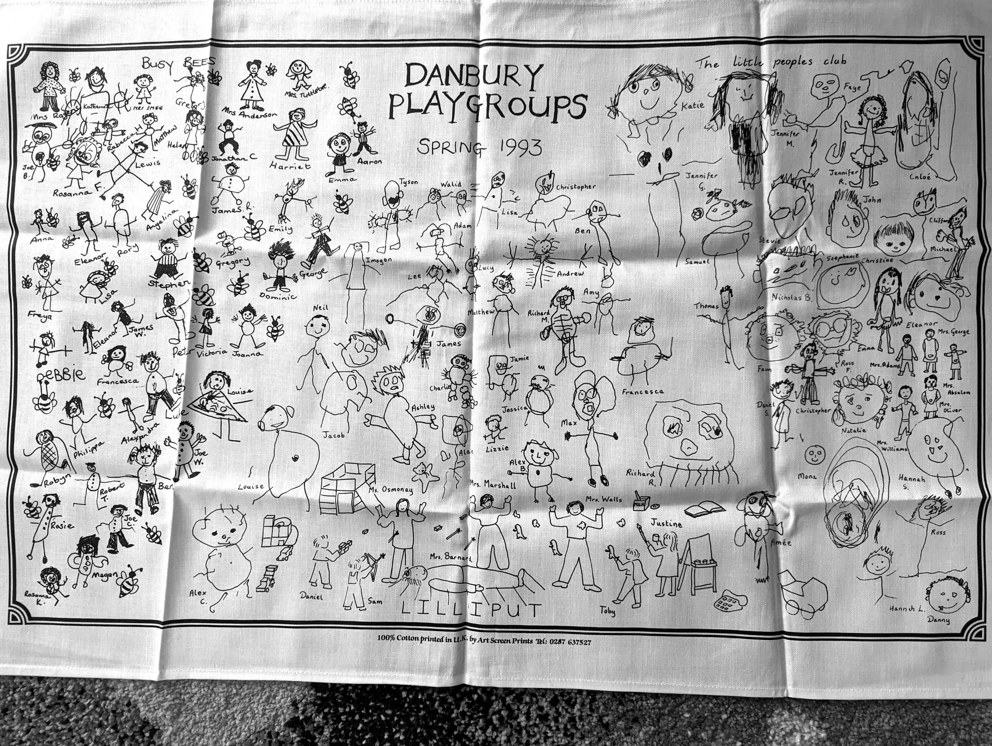
Illustration
A TEA TOWEL
Images of
2-3 yr-old kids
Must fit on the paper
No photocopiers, no technology available

Slide 9

were the Teachers
Intrusive or invisible?
BUSY BEES (left) – teacher holds student’s hand and “helps” create stick figures, ’cause that’s what’s expected.
LILLIPUT (center) and LITTLE PEOPLES CLUB (right) - Kids draw pictures, then some kind person transcribes them, making them smaller, trying to copy exactly what/how the children drew themselves, ’cause that’s the artists’ intent.

Slide 10
When are EDITORS
INTRUSIVE OR INVISIBLE?
INTRUSIVE
Changes what you
(the YOU of YESTERDAY)
originally wrote: Important for
First draft edits (where you see what went wrong with the story)
Articles for a website or magazine (which might have rules about how things are referenced)
INVISIBLE
Minimal changes to what you (or someone else) wrote: Important for
Final draft edits (when the story’s ready to go)
Editing for a client whose novel is ready to go
Editing for our anthology

Slide 11
Intrusive and invisible editing for your book
WAIT 3 days/weeks/months/years. Then READ like a READER.
INTRUSIVE EDITS
  YOU OF TODAY collaborates with YOU OF YESTERDAY to make the INTRUSIVE EDITS that turn a first draft into a readable book.
When you can read the “book” without hating the “author,” you’re ready to switch from intrusive for
INVISIBLE EDITS
  YOU OF TODAY edits YOU OF YESTERDAY’S book invisibly.
You’re not trying to make this the most perfect book the YOU OF TODAY would write. You have to respect your previous self, just as much as you’d respect a paying client.
And then you STOP.

Slide 12

EXAMPLES OF
INTRUSIVE Editing
First draft of your novel – maybe you should have introduced this character in more detail. Can you show this scene instead of telling? Is this the best place to start the story…? How?
Read like a reader – you’re not the same person you were when you wrote it. Make suggestions to yourself. Then the you of today becomes the co-writer and fixes things.

Slide 13

EXAMPLES OF
INTRUSIVE Editing
Article for an Amazon bookseller’s blog – all book titles must be in the form Book Title by Author Name (http://amazon.com/...).
No paragraphs longer than three lines.
No long sentences…

Slide 14

EXAMPLES OF
INTRUSIVE Editing
Recipe book for the British Dairy Council –
  all recipes must begin with milk.
  Cheese comes before eggs.
  All units must be metric.
  All first sentences must mention the benefits of milk…

Slide 15
Examples of invisible editing
BOUNDARIES
Like making the kids’ images fit between the lines, “boundaries” make it possible for your text to “fit” and follow a standard “format” – makes it possible for a publisher to use it. Nothing changes except fonts, indentation of paragraphs, etc. The edits are invisible.
CONTENT
This is where you “polish” the text, removing typos, replacing wrong words, and making it look how the author intended it to look (but remember, even if it’s your book, the YOU OF TODAY is neither author nor co-author now – the edits are invisible).

Slide 16
Boundaries
Use Word styles – e.g.
Heading 3 for headings (leaves Headings 1 and 2 in case you want to add sections and subsections later).
Normal for text (simplest choice, even if it’s not the best).
Create a style (and give it a name – e.g. indented) for notes that go after the heading, attributions that go with images, left-margin or centered poetry…
See https://www.portlandwritersmill.org/help-2/using-word-with-style/ for more info.

Slide 17
Boundaries (continued)
Remove irregularities
Paragraphs are indented with “Word Style” so remove extra spaces or tabs.
Space after a period is determined by Word, so remove those double-spaces.
Space between paragraphs is created with “Word Style” so remove those extra blank lines.
Ellipses will be formatted by the publisher, so replace all “manual” ellipses with Word ones (^i) so the publisher can find them.
Unbreakable spaces and manual line breaks should be used only where needed – look for ^s and ^l – e.g. World War II shouldn’t split across lines.
See https://www.portlandwritersmill.org/help-2/tips-and-tricks-with-word/ for more details.

Slide 18

A quick note about our website
Go to the website: https://www.portlandwritersmill.org/
On a phone/tablet, click on three lines to get the “menu”. Otherwise look at the green menu line under the image.
Signup is where you sign up for newletters (when they’re working)
About tells you who we are
Contact us contains useful email addresses
Help - arrow opens a “sub-menu” with LOTS of helpful articles – e.g
  Style guide, using word with style, tips and tricks with word…
Schedule, contest/ezine, critique, links, books, library…

Slide 19
content
Remove typos, wrong words, accidentally repeated words… this should be obvious. Aim to fix problems like:
  speakers who’ve already left the room
  dialog where you’re not sure who’s speaking
But what about enforcing obedience to “rules” you learned in school?
  new paragraphs for new speakers
  “correct” use of commas, em-dashes, en-dashes…
  run-on sentences
See https://www.portlandwritersmill.org/help-2/writers-mill-anthology-style-guide/ for more info, and develop your own style guide (though your publisher’s may be different).

Slide 20
How to practice invisible editing
Sign up to be an editor for our anthology!
Your job is to polish each piece of writing to most perfectly represent the author’s intent, whether the author is a stranger, a friend, or YOU OF YESTERDAY. Your (YOU OF TODAY’s) opinion, your style, your preferences are just as irrelevant as they would be when someone’s paying you to edit. YOU ARE NOT THE AUTHOR!
THE EDITOR (at this stage) is (supposed to be) invisible.

Slide 21





EXAMPLES OF INVISIBLE EDITING
We’re expecting four different types of content for our anthology, and you probably write (and therefore self-edit) in one or more of these styles:
      Poetry
      Essay
      Chapter from a longer work
      Short story

Slide 22
poetry
There are lots of different styles of poetry:
All lines start with capital letter, or no capital letters anywhere in the poem
All lines combine into complete sentences, or lots of partial sentences
All lines rhyme at the end, or loose (maybe no) rhyming scheme
All lines fit a standard rhythm, or loose (maybe no) rhythm used
All stanzas of equal length, or random (maybe no) stanzas …

Slide 23
Invisible editing for poems
Do not change the author’s style (even when the author is yesterday’s version of you)
If something is confusing, make a comment to the author.
If a rhyme is awkward, make a suggestion.
If the rhythm slips in one line, make a suggestion.
If a rhyme only works in American... (see next slide).
You make suggestions. The author is free to accept or reject your ideas.

Slide 24
An English/American POEM
His farm is neat
His fruit is sweet
He grows tomatoes
Carrots and potatoes
Ask the author, would you consider He grows potatoes
Carrots and tomatoes?
to clarify the rhyme for English readers. The author is free to say no.

Slide 25
ESSAYS
We all write essays differently too:
Intro paragraph, followed by 2 or 3 content paragraphs, followed by conclusion
New topic for each paragraph
Stream of consciousness, story-style essay with lots of well-spaced dialog …

Slide 26
Invisible editing for essays
Again, don’t change the author’s style.
If paragraphs are split by topic, and one paragraph contains a section of dialog, don’t try to split out the dialog into new paragraphs, even if you do “know” that’s the “rule”.
(But do suggest adding dialog tags if it’s not clear who’s speaking, for example.)
If the spelling is consistently British, don’t change it to American.

Slide 27
A dialog/paragraph example
When I was in high school the students argued incessantly. “Are you an Indian?” “No I’m not.” “Well, are you Mexican then?” “Korean,” “French.”
Ask the author, should Korean and French have question marks after them? Or is the narrator saying she is French? Offer choices:
“Korean?” Then I would tell them, “French.” or
“Korean?” “French?”
The author might make some different change,
but it needs something, so you can insist on some change.

Slide 28
chapters
If the chapter opens with a paragraph referring to the previous chapter (and maybe characters who won’t appear in this chapter), you might ask the author to leave out that paragraph and maybe include a summary in a note at the start of the “story” instead.
If the chapter ends with a paragraph leading in to the next chapter (and maybe not relevant to the events of this chapter) you might ask something similar, for the benefit of readers.

Slide 29
A Chapter example
After all the excitement of the contest, the announcements, the riot, and the imprisonment of Joe, David, and Griselda, Michael and Elizabeth set off for home alone.
The next day, Michael went to work as usual, leaving Elizabeth asleep in their four-poster bed…
If Joe, David, and Griselda are never mentioned in this chapter, maybe suggest the chapter start at The next day and have a note below the title saying
In the previous chapter some friends of Michael and Elizabeth were arrested and imprisoned. This chapter starts the following day.
The author might make a different change, but
some change is needed, for ease of reading, so you can insist on something.

Slide 30
short stories
If the author never uses quotation marks, that’s fine. But if they use single instead of double quotes, change them to match American usage (because they’re visible to readers).
If the author doesn’t use Oxford commas, don’t insert them (they’re not very visible), but do make sure the use of commas is consistent. Suggest inserting commas where the reading is awkward or unclear.
If the author uses incomplete or run-on sentences, let them stand unless they’re hard to read, in which case you might make suggestions (but don’t make changes – let the author choose how to change it).

Slide 31
Short story example
  “Hello,” he said.
  “Hi,” she said.
  “What are you doing?” he said.
  “I’m trying to read,” she said…
Maybe suggest another word instead of said, or suggest leaving out some of the saids or including an action… Might suggest:
“Hello,” he said.
“Hi.”
“What are you doing?”
“I’m trying to read.” She turned another page…
But the editor doesn’t make the changes, and the author doesn’t have to agree, unless it’s really hard to read.

Slide 32





Self-editing
So …
How do you WRITE, EDIT, and STOP
(and most importantly, how do you STOP editing)?

Slide 33




Write, edit, and stop
Write, in whatever way works for you.
Race to the finish
Climb the mountain and leave signposts to help with the rewrite
Backstitch – writing and editing as you go
Then wait – 3 days, 3 weeks, 3 months, 3 years…

Slide 34
Write, Edit, and Stop
Start with INTRUSIVE EDITS
Read it like an ebook (or a print book – print it out). Whenever the “author” (YOU OF YESTERDAY) drives you (YOU OF TODAY) crazy, make notes to advise the author on changes, then read the notes and (collaborate with yourself to) make the changes you want.
Then wait, and reread it like a book. Repeat till the author (who is, again, not YOU OF TODAY) doesn’t drive you absolutely crazy. Then…
INVISIBLE EDITS
This time you’re just reading to polish the author’s work – no big changes allowed - after which…

Slide 35
Write, Edit, and Stop
STOP !
It’s written.
It’s edited.
It’s done!
It’s a book by YOU OF YESTERDAY
edited by YOU OF TODAY.

Slide 36
And now we’re done
At this point Sheila asked for volunteers to help edit the anthology. Please consider volunteering, and practicing your invisible editing skills!

